Slide 1
Open Science cloud access to LOFAR data and compute
EOSC Pilot Workshop, Pisa, 13 Sept 2017
Rob van der Meer, ASTRON
Hanno Holties, ASTRON
Niels Drost, eScienceCenter
Coen Schrijvers, SURFSara
Michael R. Crusoe, CWL
et al.
Notes:
Honoured to be selected as pilot in the project. Relatively new to EOSC and LOFAR details. Thanks to Hanno and others for reusing slides of earlier presentations.

Slide 2
Menu
Radio Astronomy & LOFAR
Data storage structure
Data challenges
User requirements
Use cases
Project plan
Resource requirements
Interoperability requirements
Success criteria of SD
Summary

Slide 3
Astronomy (Radio)
Andromeda Galaxy (Multi-wavelength View)
Electromagnetic
Wavelength
longer
shorter
Notes:
Astronomy stretches over many wavelengths, each addressing different physics parameters of the objects.
Some researchers want to just study the physics addressable by radio astronomy, others want to have a multi wavelength or even multi-messenger view, including gamma rays, neutrinos, gravitational waves.
We are “spoiled” with the high resolution of the Hubble (visible) images. Achieving the same resolution in Radio images for comparing with other wavelengths and more detailed study of the objects, radio telescopes need to be Megametres wide

Slide 4
Astronomy (Radio)
Andromeda Galaxy (Multi-wavelength View)
Detector size same resolution
1000 km
1 m
Notes:
Astronomy stretches over many wavelengths, each addressing different physics parameters of the objects.
Some researchers want to just study the physics addressable by radio astronomy, others want to have a multi wavelength or even multi-messenger view, including gamma rays, neutrinos, gravitational waves.
We are “spoiled” with the high resolution of the Hubble (visible) images. Achieving the same resolution in Radio images for comparing with other wavelengths and more detailed study of the objects, radio telescopes need to be Megametres wide

Slide 5
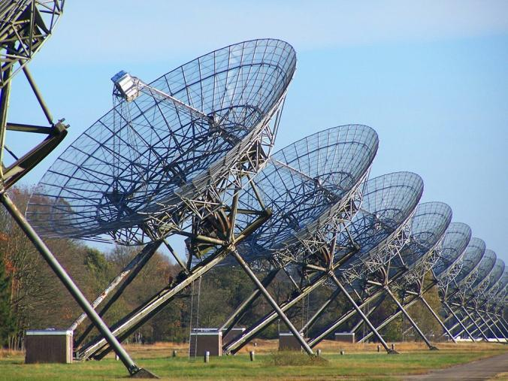
Westerbork Synthesis Radio Telescope -- data production --
Due to the long wavelength nature of radio astronomy, special techniques have to be used to “image” the sky.
The signal need to be continuously digitized to correlate the data →
Radio Telescopes produce substantial amounts of data, with volumes of “astronomical” proportions
Notes:
Single receiver no spatial info
Combining receivers in so-called baselines representing Fourier components
WSRT uses earth rotation for a full 2D scan
Digitized signals mostly noise

Slide 6
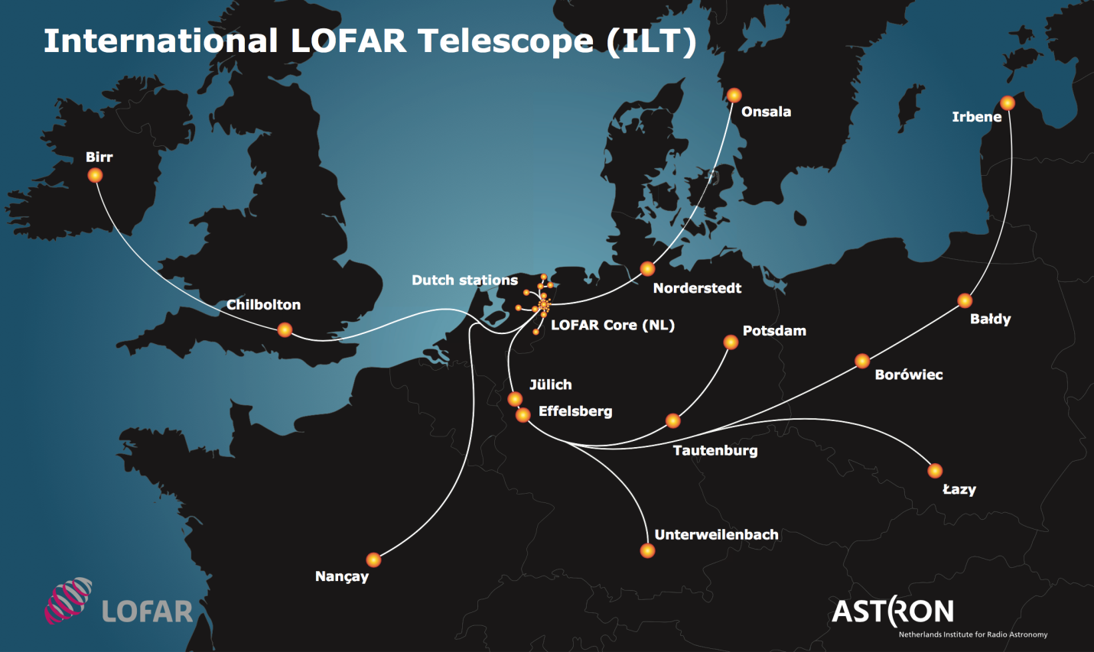
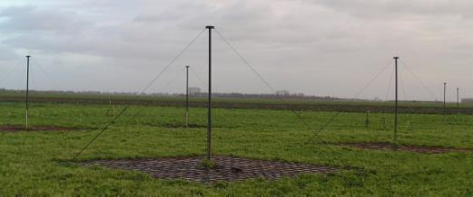
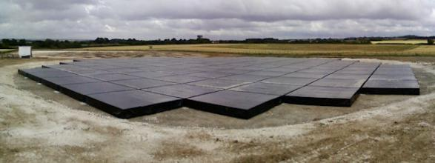
Radio Astronomy at scale: International LOFAR Telescope
Notes:
The technical requirements of LOFAR have been driven by a broad and diverse range of scientific goals [1]. Amongst others, these goals include wide-field, high dynamic range imaging, near real-time detection of radio transients, high accuracy pulsar timing, solar monitoring, and radio pulses generated by cosmic ray air showers. To achieve such a wide spectrum of scientific requirements, the system has been designed and built to be both highly flexible as well as extensible [2]. This is achieved by using many small antennas instead of dishes, which are digitized at an early stage in the signal chain. Doing so, an operator is able to point the telescope simultaneously in multiple directions and schedule multiple observations at the same time increasing the efficiency of the telescope. Furthermore part of the flexibility is realized by using custom off the shelf computing hardware for the central systems where all data of the fields is combined. In this way imaging observations can be mixed or followed with other types of observations easily.

Slide 7
Radio Astronomy at scale: International LOFAR Telescope
Correlator Groningen, NL
Poznan, PSCN, PL
SURFSara, NL
3 Gb/s/station
7 PB/y LTA
Juelich, DE
Notes:
The technical requirements of LOFAR have been driven by a broad and diverse range of scientific goals [1]. Amongst others, these goals include wide-field, high dynamic range imaging, near real-time detection of radio transients, high accuracy pulsar timing, solar monitoring, and radio pulses generated by cosmic ray air showers. To achieve such a wide spectrum of scientific requirements, the system has been designed and built to be both highly flexible as well as extensible [2]. This is achieved by using many small antennas instead of dishes, which are digitized at an early stage in the signal chain. Doing so, an operator is able to point the telescope simultaneously in multiple directions and schedule multiple observations at the same time increasing the efficiency of the telescope. Furthermore part of the flexibility is realized by using custom off the shelf computing hardware for the central systems where all data of the fields is combined. In this way imaging observations can be mixed or followed with other types of observations easily.

Slide 8
LOFAR Long Term Archive -- Purpose & Use Cases --
High Level Use-Cases:
Ingest Data
Store Data
Query Meta-data
Retrieve Data
Monitoring & Control
1. Ingest
3. Query
5. Monitoring
& Control
4. Retrieve
ALTA
Online storage
Meta-data
Control
2. Store
Cold storage

Slide 9
EOSC Pilot tasks
Raw data
Data products
Dedicated facilities
Cloud facilities
Pipeline reduction
Analysis etc.
Final user data, images etc.
Single object image
Pulsar timing
spectroscopy
EoR
Make this
border shift left
by facilitating compute
Make this side better accessible
Notes:
In Telescope pipeline from antenna signal to visibilities
Early reduction steps are embarrassingly parallel → HTC
Steps to imaging could be HPC

Slide 10
Data challenges
Where is my data?
Move data to local cluster
Data provenance
Data access with gftp
User access with Grid certificates, user database at ASTRON
Data can be in multiple LTA sites

Slide 11
User requirements
Old/current:
I want to do what I want to the data
I want to have my data
Move users to new requirements:
What is my data?
How can I analyse it?
Federated identity

Slide 12
Use cases
Facilitate easy access for power user. Facilitate free/sandbox compute with own algorithm, parameters, etc. on small local data set.
Then scale up to larger data set on remote cluster
Make the Lofar Archive Accessible to non power users
Provide non-expert user with standard pipeline, and gui for ~10 free parameters
Use this demonstration to show both possibilities and limitations of current software and e-Infrastructure.

Slide 13
Project plan I
Define the “perfect” environment as far as we know for the use cases.
immediately start building with existing tools and resources without optimising them first, to show not only limitations, but that a total system is possible.
from there define new projects for improving the working system.
Notes:
In case of choice of tools, take the first available to make it work. Only if it really breaks, change to another, or as part of the improvement at the end.

Slide 14
Project plan II – some elements of approach
Access Lofar Archive (initially SURFsara archive)
Look into connectivity to other archives
Standardize the existing pipelines for a few science cases using the Common Workflow Language (CWL)
Investigate notebooks
Build a web frontend for running these pipelines, and allow users to change settings, input dataset, etc
Use an existing viewer (eg based on rabix.io) to view the resulting workflow
Look into the current downloadserver and other Lofar data retrieval elements. Perhaps put a new frontend on top of the current systems.
Use Zenodo/B2Share and Research Object to export the resulting data to a persistent storages, with a DOI, etc.
Notes:
Disclaimer: These are the first ideas, not yet planned steps

Slide 15
Project plan III – more elements of approach
How this is different from HEP (via presentation @ EOSCPilot workshop):
Separate containers for each standalone software
We model/preserve how the tools are connected via CWL
We will model tool resource usage to enable compute resource matchmaking
Identifiers for each tool
Detailed attribution of contributors via CWL+RO
Notes:
CWL (www.commonwl.org)
RO (http://www.researchobject.org/)

Slide 16
Resource requirements + Interoperability requirements
Access to data in the LOFAR LTA @ SURFsara
Acces to compute facilities @ SURFsara
Access to data in the LOFAR LTA @ Juelich
Transport of data between LTA sites
Contact with GÉANT
Access to compute facilities at other sites

Slide 17
Success criteria of SD
Demonstration that a complete system can be constructed from existing tools.
+ Power user more satisfied over the system performance
+ More non-expert users using the system and more satisfied over system performance

Slide 18
Summary
The team is defining the plan these weeks, so this presentation is work in progress.
The first actions will follow soon, leading for sure to system changes in the plan: Plan and Build as we go.
The team is very enthousiastic to create something and show that it works.
Thank you.

Slide 19
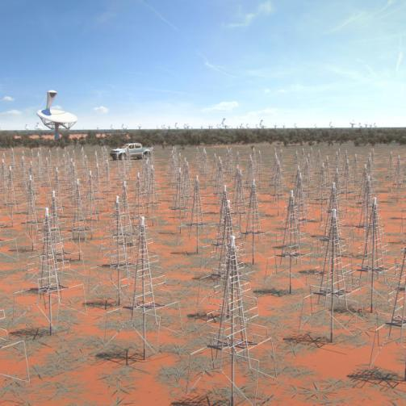
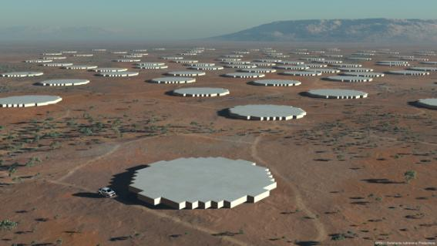
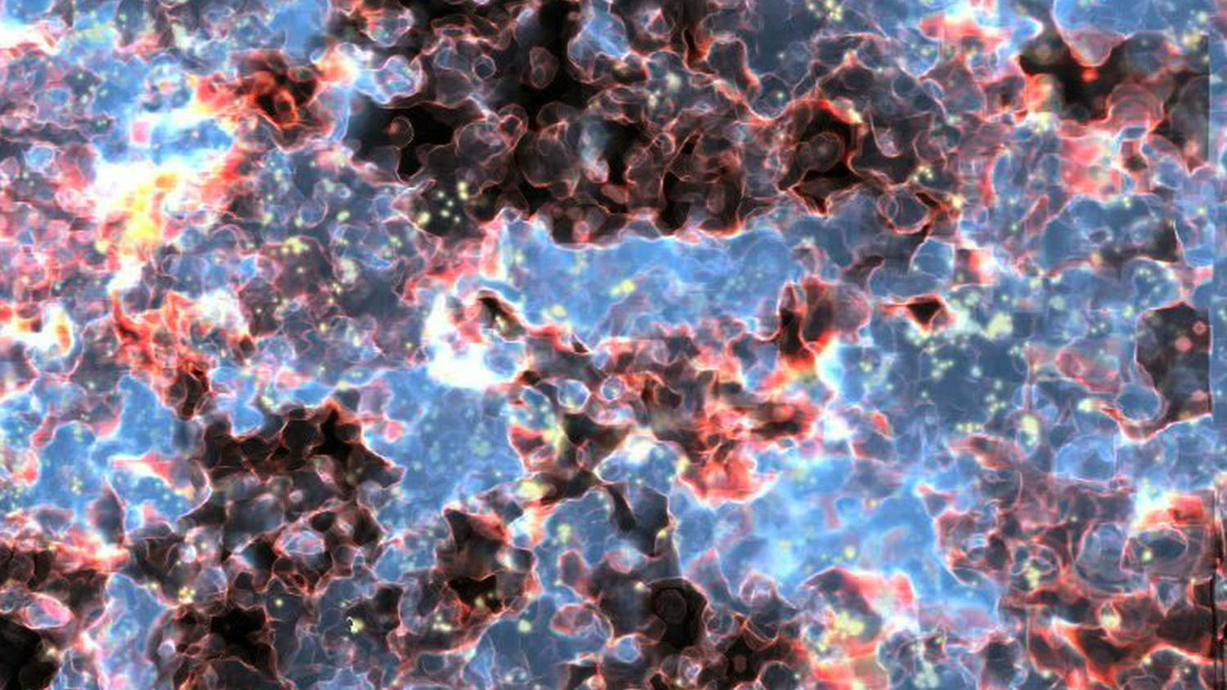
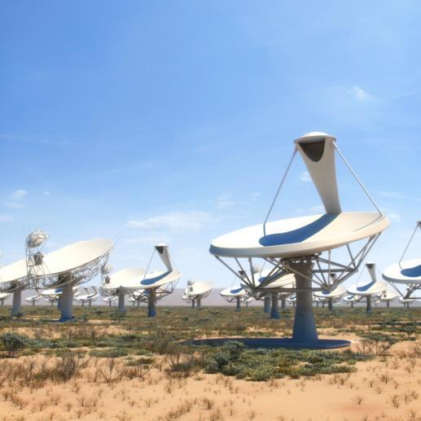
Square Kilometre Array Taking it to Exa-scale
Start of construction
2018
http://skatelescope.org
Notes:
Aperture arrays capable to produce more than 100x global internet traffic (production rate SKA > 10x)

