Slide 1
The e-Infrastructure Commons
e-IRG Infrastructure Commons;
interoperability and integration: lessons learnt
Arjen van Rijn
Nikhef (National Institute for Subatomic Physics)
e-IRG delegate (NL, SURF)
EOSCpilot Governance Development Forum workshop
3 October 2017

Slide 2
e-IRG
Vision:
to facilitate integration in the area of European e-Infrastructures and connected services, within and between member states, at the European level and globally.
Mission:
to support coherent, innovative and strategic European e-Infrastructure policy making and the development of convergent and sustainable e-Infrastructure services.

Slide 3
The e-Infrastructure Commons
An ecosystem of ICT services for scientific research
attained through a joint strategic effort between users and primary strategic actors and suppliers,
in which providers have the freedom to innovate and …
where users enjoy the freedom to choose the services they need from a mix of public e‑Infrastructure and commercial services, so that …
users can focus on doing of science, in (international) research collaborations, whilst avoiding spending effort on the requirements to access various services;
(e-IRG 2013 White Paper)

Slide 4
The e-Infrastructure Commons
Buzzword compliance
“Commons”
“Cloud”
“Open”
“Data”

Slide 5
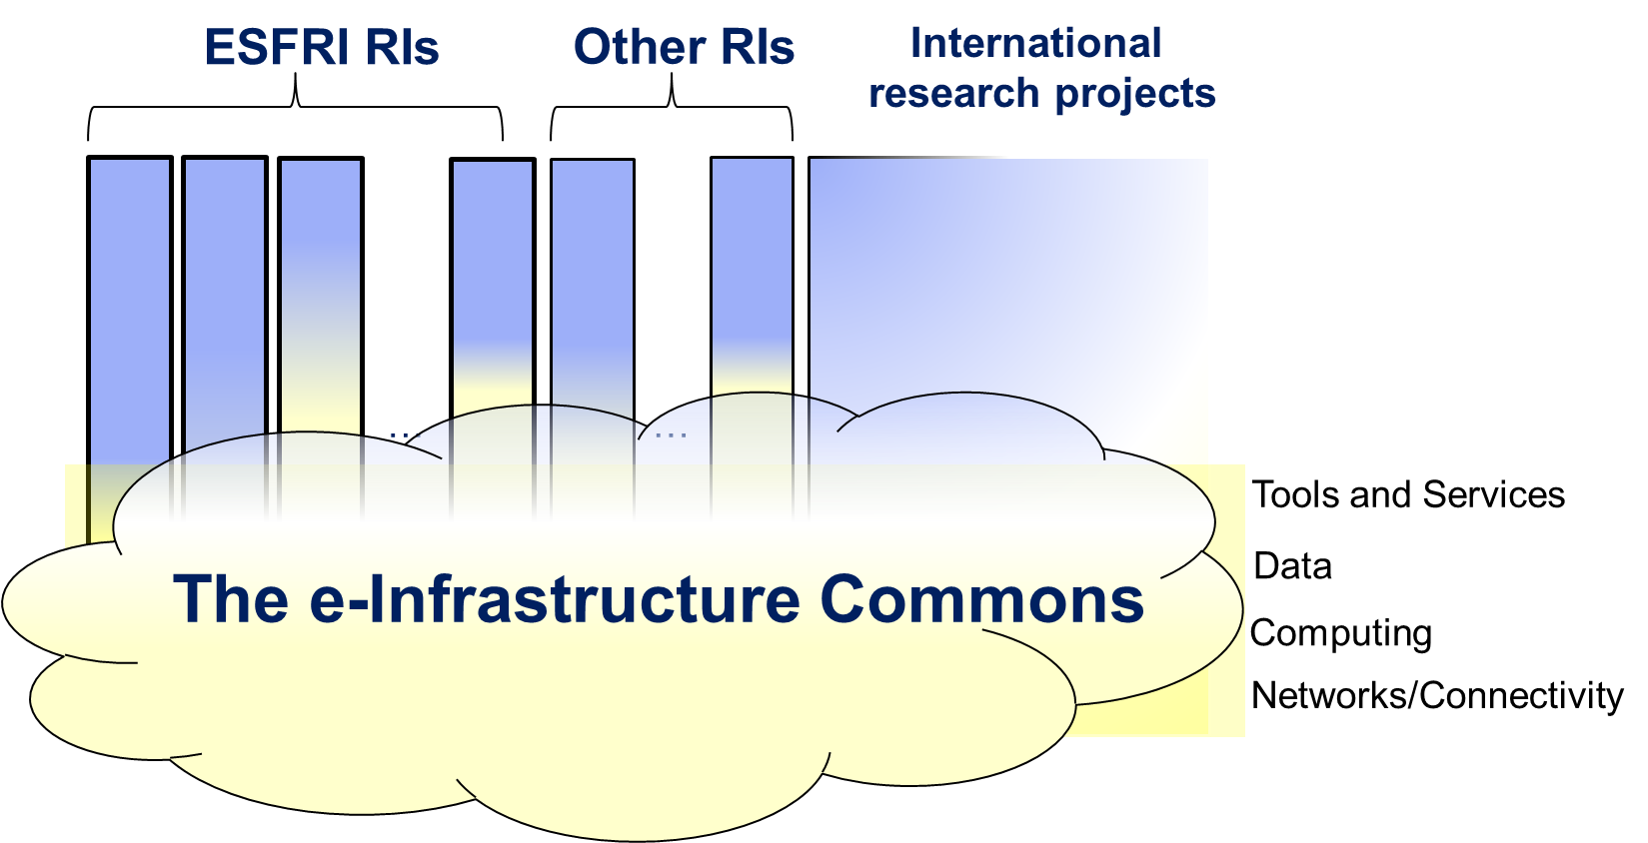
The e-Infrastructure Commons

Slide 6
The e-Infrastructure Commons
Recommendations for strategic actors:
International user groups (ESFRI and other RIs): “organize yourself”
European and national e-infra organizations: “team up!”
National governments and funding agencies: “fund an innovative and sustainable national e-infrastructure; empower and fund user communities”
European Commission: “encourage and facilitate innovation; empower international user groups”
Existing e-infra providers: “innovate or perish”
(e-IRG White Paper, 2013)

Slide 7
So, let’s have a closer look
at these recommendations
and their follow-up

Slide 8
User communities (RIs): organize yourself!
e-IRG Roadmap 2016:
Drive the long term strategy for their e‑Infrastructure needs;
Participate in the innovation of e‑Infrastructure services;
Contribute to standards and take care of your data;
Indications of progress:
“e-Needs” in ESFRI Roadmap process (application): a very useful exercise!
Increasing awareness within user communities/RIs of data quality, data management, data handling and consequences for e-infrastructure requirements;
FAIR concept
RDA activities, GEDE

Slide 9
User communities (RIs): organize yourself!
ESFRI Roadmap and e-Needs
4.1 Outline the Data Management Plan (DMP) and data access policy of the RI. If applicable, describe how data would become accessible to the public.
4.2 Describe and quantify what e-infrastructure services - e.g. resources for storage, computing, networking, tools for data management, security, access, remote analysis, etc. - your RI will need.
4.3 Describe how the e-infrastructure services needed by your RI will be implemented, specifying the potential need of external e-infrastructure resources and the relations to external e-infrastructures.
4.4 Describe how the RI will contribute to the development of the European and global e-infrastructure landscape at all levels (institutional, regional, national, international) - including e.g. the e-infrastructure commons and the European Open Science Cloud (EOSC).
(See also: Guide to e-Infrastructure requirements for European Research Infrastructures. An e-IRG Support document, 1 March 2017)

Slide 10
e-Infrastructure organizations: team up!
e-IRG Roadmap 2016:
“Convergence amongst the European e-Infrastructure organizations is taking place, but progress is too slow.
e-IRG concludes that a coordination platform among all stakeholders inline with the Commons … is needed. One of the proposed solutions … could be the introduction of interoperable services catalogue. […] Preferably this coordination platform is built up from strong national building blocks.”

Slide 11
National governments and funding agencies
e-IRG Roadmap 2016:
e-IRG recommends strongly, that e-Infrastructure coordination and consolidation on the national level is embraced in full force in every European country. A strong European e-Infrastructure is dependent on strong national building blocks.
e-IRG supports strongly that national e-Infrastructure funding and governance mechanisms are analysed, so that best practices can be identified, which can contribute to more specific recommendations to national governments and funding bodies.

Slide 12
National governments: strong building blocks!
e-IRG Roadmap 2016:
“e-IRG believes, that the funding system must facilitate the right incentive structure to reach the ideal situation, believed to be consisting at least of a balanced mix of:
base funding for the innovation of the (national) e-Infrastructure;
funding by users derived from service delivery by the providers;
top up funding based on (national) priorities for (demanding and well organized) research communities;”

Slide 13
National context (NL) –
e-infrastructure landscape
National building block: pivotal role!
Research infrastructure
Grants + guidelines
International
Examples from the life sciences
Dutch
Institutional
RUG Lifelines
LUMC Shark Cluster
VUMC NCAGRID

Slide 14
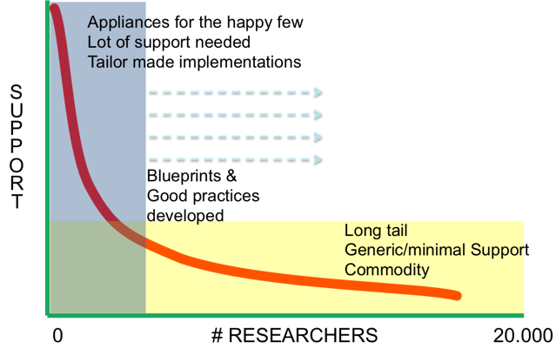
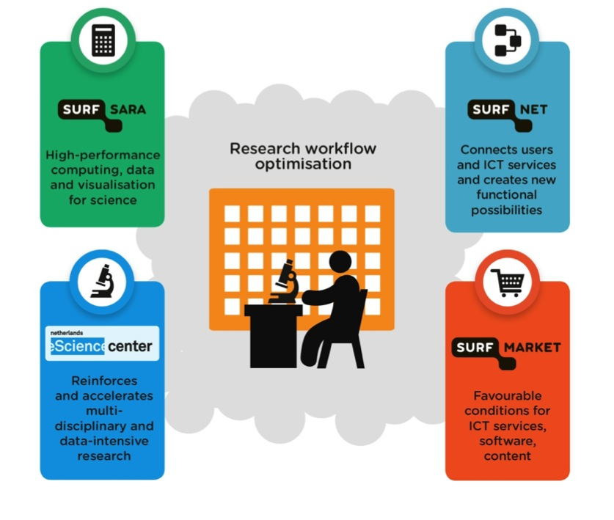
National context (NL) – S4R
SURF support4research (S4R)

Slide 15
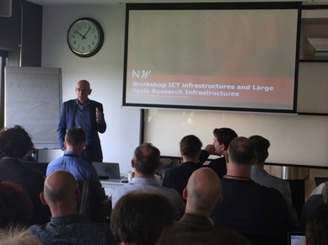
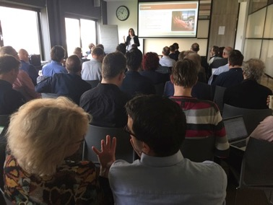
National context (NL) – research funding
Goal
Help shape e-infrastructure requirements and funding at the proposal stage of research projects;
Activities
Presented SURF services during Netherlands eScience Center call information sessions;
Organized first national e-infrastructure session for NWO Roadmap proposers (i.e. Large Research Infrastructures);
Assigned points of contact to projects;
Impact
Alignment of e-infrastructure needs early in the project planning phase

Slide 16
National context (NL) – some lessons learnt
All visited institutes are implementing research support
Institutes often uncertain where to start
Institutes asking for input, both from peers at other institutes and from SURF
Degrees of funding and proficiency vary
Most local ICT groups want to be involved in e-infrastructure support
Stick to ‘local first’ principle
Institutes with own e-infrastructure see a role for themselves on the (inter-)national level
Federating resources might be the practical solution …
People want one point of contact for all e-infrastructure services
Viable alternative: no-wrong-door policy
The perceived value of (inter-)national e-infrastructure providers is in expertise, not in machines
Training is required, both for research supporters and scientists
e-infrastructure related
Generic ICT skills (basic programming, version control, Unix proficiency, etc.)

Slide 17
European Commission
e-IRG Roadmap 2016:
develop the necessary harmonised scope, framework and instruments for improving Research Infrastructures, including e-Infrastructures in terms of operations, innovation and sustainability.
e-IRG recommends that in future Work Programmes the EC provides strong incentives for cross platform innovations, thereby further supporting the need for coordination and consolidation of e-Infrastructure service development and provisioning on the national and the European level.

Slide 18
Governance? A personal note ….
Governance: who decides on what, and how.
Multi stakeholder model: sure, but don’t make it fuzzy …
Three groups of stake holders:
Funders
Research Infrastructures (user communities)
E-infra service providers
Three levels to cover:
Local (institutional)
National (member state)
European (international)

Slide 19
Enough to discuss!
Thank you.

