Slide 1
Brief introduction of the Architecture work done so far
Donatella Castelli
CNR-ISTI

Slide 2
Open Science
A systemic change in the modus operandi of science and research
Affecting the whole research cycle and its stakeholders
Commissioner Carlos Moedas Open Science Presidency Conference Amsterdam, 4 April 2016
EOSC as an evolving system serving a multitude of actors

Slide 3
Open Science
“Open Science represents a new approach to the scientific process based on cooperative work and new ways of diffusing knowledge by using digital technologies and new collaborative tools. The idea captures a systemic change to the way science and research have been carried out for the last fifty years: shifting from the standard practices of publishing research results in scientific publications towards sharing and using all available knowledge at an earlier stage in the research process.”
“Open Science has an impact on the entire research cycle, from the inception of research to its publication, and on how this cycle is organised.”
EOSC supporting collaboration & sharing

Slide 4
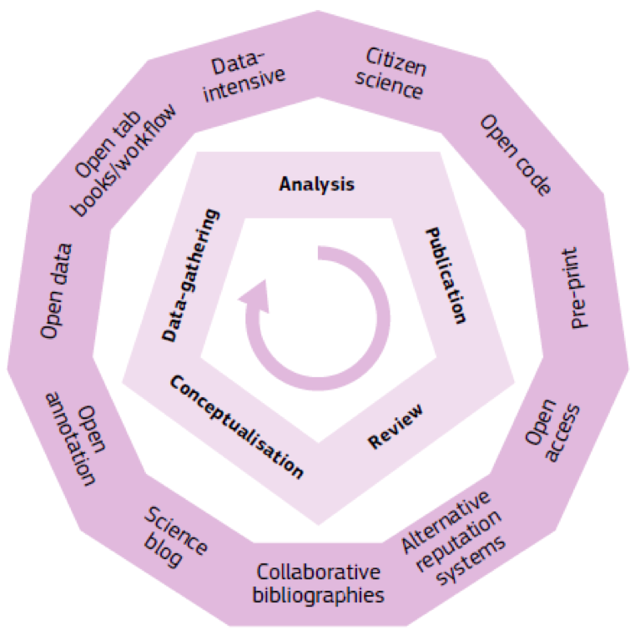
Open Science opens up the entire research enterprise…..
Open Science opens up the entire research enterprise (inner circle) by using a variety of means and digital tools (outer circle) [EC - DG R&I 2016, p. 36]
EOSC as a facilitator of new scholarly and scientific processes

Slide 5
Factors influencing the EOSC adoption
Trust: EOSC services must exhibit a level of quality, sustainability and, more in general, trust at least comparable to the solutions that the scientists are used to employ today.
Cost/benefits: EOSC services must offer a convincing decreasing of the rate cost/benefit
Representativity: the new EOSC must offer an inclusive presence of all scientific disciplines and key infrastructures and service providers
Open access: as open as possible and as closed as necessary
Factors to be taken into account in designing the EOSC architecture

Slide 6
Suggestions from experts
It should be a “federated, globally accessible environment where researchers, innovators, companies and citizens can publish, find and re-use each other's data and tools for research, innovation and educational purposes” [OSPP EOSC report]
It should “build on existing capacity and expertise where possible”
It is approached as a “federated environment for scientific data sharing and re-use, based on existing and emerging elements in the Member States, with lightweight international guidance and governance and a large degree of freedom regarding practical implementation”
“It should enable trusted access to services, systems and the re-use of shared scientific data across disciplinary, social and geographical borders”
Basic “principles” for the implementation of the EOSC system architecture

Slide 7
EOSCPilot Objective
EOSC Reference
Architecture
EOSC Concrete Architecture/Implementation
What are the existing systems/services?
What do they provide?
Who can operate what service?
What are the goverance/sustainability constraints?
……..
A reference architecture models the abstract architectural elements in the domain of interest independent of the technologies, protocols, and products that are used to implement a specific solution for the domain
January 2017
December 2018
2020
EOSCPilot project
EOSCPilot follow-up

Slide 8
Modelling choice 1: System-of-systems
Operational and managerial independence
Geographical distribution
Emergent behavior
Evolutionary development
Heterogeneity of constituent systems
each system is independent and it achieves its purposes by itself and for its own objective rather than for the purposes of the SoS
a SoS is distributed over a large geographic extent
a SoS has capabilities and properties that do not reside in the component systems
a SoS evolves with time and experience
a SoS consists of multiple, heterogeneous, operating systems embedded in networks at multiple levels
Components:
Exiting and emerging RIs, e-Infras, data repositories, registries,…
Notes:
http://rs.ieee.org/component/content/article/9/77-system-of-sys

Slide 9
Modelling choice 2: As-a-Service
as-a-Service provision model, i.e. all the services in the EOSC catalogue are managed and delivered by a known service provider
The technical and organisational solutions needed for operating the service to completely up to the service provider

Slide 10
Choice 3: Approch to the identification of services
EOSC System
Actor roles
Policies
(Rules of Engagement)
Services
Notes:
open science friendly: there is no a priori decision with respect to services that should appear in the EOSC catalogue and services that should not. This is simply a consequence of the fact that EOSC services are expected “just” to be instrumental to “open science” scenarios that are not known in advance. Thus every service in the EOSC catalogue should be annotated with a multi-dimensional degree of open science friendliness, i.e. a set of attributes helping to understand to what extent the specific service is open science friendly. These attributes should help to understand “how much” the (research) artefacts resulting from their exploitation are “open science friendly”. The detailed list of attributes, the metrics and the procedure to assess them have to be designed and developed;
Heterogeneous and comprehensive: the vast majority of EOSC services pre-exist EOSC, new ones will emerge during EOSC lifetime, and the lack of a global model for services and service providers to comply with require that EOSC should deal with (a) possibly homologous services that are diverse (to some extent) and (b) services operating at completely diverse application layers that is almost impossible and misleading to compare. Moreover, EOSC services possibly cover the provision of the entire stack of “resources” that can be used in an Open Science scenario. They are expected to range from those close to end-users, e.g. services included in the Application-as-a-Service or Data-as-a-Service layer, to those helping service providers to implement and operate new services conceived to serve end-user in open science scenarios;
multi-tenancy and long-term: service instances should be conceived to serve multiple users and communities. Although this is not mandatory yet it should be envisaged. Moreover, service (instances) are expected to be available for long-term thus to offer some form of guarantee wrt open science mantra such as “repeatability” and “reproducibility”.

Slide 11
EOSC Services
PID Service
Alert Service
Recommender Service
Data Catalogue
IT Security
Operational Service Mgmt
Metadata Enrichment
Metadata Linking
Metadata Validation
Citation Service
Environment continuity
Operations bridge
Workflow Service
Service Catalogue
Repository Service
Repository Validation
Policy and Licence Helper
Semantic Integration Helper
VRE Factory
Service continuity
Service Desk
VRE Factory
Shared Workspace
Social Networking Service
Scientists
Service Catalogue
Services for EOSC Managers
IDE as_a_service
RStudio
MatLab
Validation Environment
IT Security
Environment operations
Software Repository
Assessment Environment
Service Desk
VRE Factory
Developer Scientists
Validation Environment
Transition Environment
Service Catalogue
IT Security
Operations bridge
Data Catalogue
Environment operations
Service transition
Service Developers
VRE Factory
Service Desk
Service Dashboard
Service Catalogue
IT Security
Multi-supplier coordination
Services for …
Resource Catalogue
Service continuity
Service Providers
Service Desk
Infrastructure Providers
Infrastructure Dashboard
Service Desk
Multi-supplier coordination

Slide 12
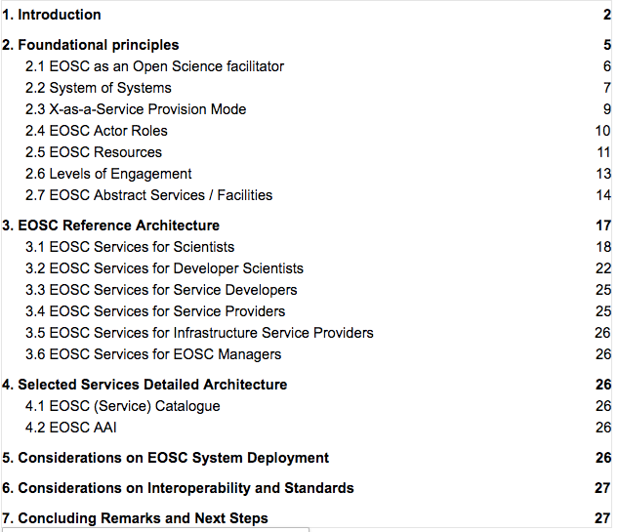
What done so far
The European Open Science Cloud Architecture: Anatomy and Physiology
https://docs.google.com/document/d/1Oi2kLXt8X0Pvc0dxxX1WAca6-_d4P5O7tvHfxCj2vdA/edit#

Slide 13
Meeting agenda
10:10 -11:10 | EOSC Model Discussion about the proposed EOSC Model | Pasquale Pagano (CNR-ISTI)
11:10 -11:30 | Coffee break
11:30 -12:50 | Services for scientists Discussion about services for production, sharing and management of research artifacts and for supporting collaboration | Paolo Manghi (CNR-ISTI), Leonardo Candela (CNR-ISTI)
12:50 -13:50 | Lunch
13:50 - 14:50 | Services for developer scientists Discussion about services for scientists developing their own domain specific tools using popular frameworks | Gianpaolo Coro (CNR-ISTI)
14:50-15:50 | Services for service developers and service providers Discussion about services supporting IT experts in developing and delivering EOSC services | Sy Holsinger (EGI)
15:50 -16:10 | Coffee break
16:10 - 16:40 | Services: anything else? Discussion about any other aspect & required service type | Tiziana Ferrari (EGI)
16:40 -17:40 | EOSC service portfolio management: EOSC portfolio presentation Discussion about the management of service catalogue(s) | Jan Bot (SURF-sara)
09:00 -09:10 | Copernicus Data and Information Access Services (DIAS | Martina Sindelar, DG for Internal Market, Industry, Entrepreneurship and SMEs unit I.3 Space Data for Societal Challenges and Growth
09:10 - 10:20 | Rules of engagement Discussion about EOSC rules of engagement and their implications on EOSC services | Damien Lecarpentier (CSC)
10:20 - 11:20 | Administration and Management Services Discussion about different administration services | Tiziana Ferrari (EGI)
11:20 -11:40 | Coffee break
11:40 -12:40 | Wrap up and Next steps | Brian Matthew (STFC), Donatella Castelli (CNR-ISTI)
12:40 – 13:40 | Lunch
13:40 – 16:00 | EOSCpilot WP5 Task Leaders | restricted meeting

Slide 14
Meeting objectives
Produce a first list of “mandatory” services
Identify a shared plan for actions
Agree on a share vision
Agree on the approach
Participatory approach

Slide 15
How the meeting is organised
2-4 slides of presentation on the needs
5-7 questions
Discussion
http://tinyurl.com/eosc-pisa-minutes

