Slide 1
EOSC Governance Development Forum
EOSC Governance Framework
Matthew Dovey, Jisc matthew.dovey@jisc.ac.uk

Slide 2
EOSC Governance
EC communication on EOSC governance structure (COM(2016) 178 final):
Create a fit-for-purpose pan-European governance structure to federate scientific data infrastructures and overcome fragmentation. The institutional setup will oversee long-term funding, sustainability, data preservation and stewardship. It will build on existing structures to involve scientific users, research funders and implementers*
* Such as ESFRI, INSPIRE, eIRG, GEANT, PRACE, ELIXIR, the Belmont Forum and similar federating initiatives

Slide 3
EOSC Declaration – Governance Model
A long-term, sustainable research infrastructure in Europe requires a strong and flexible governance model based on trust and increasing mutuality. As interdisciplinarity is one of the main objectives of the EOSC, the governance model should be based on representativity, proportionality, accountability, inclusiveness and transparency.

Slide 4
EOSCPilot Objectives
EOSCpilot project will:
establish a governance framework for the EOSC and contribute to the development of European open science policy and best practice;
develop a number of pilots that integrate services and infrastructures to demonstrate interoperability in a number of scientific domains; and
engage with a broad range of stakeholders, crossing borders and communities, to build the trust and skills required for adoption of an open approach to scientific research

Slide 5
EOSC Governance
Example of basic notion of stakeholder engagement
”Those groups who can affect or are affected by the achievements of an organization's purpose should be given the opportunity to comment and input into the development of decisions that affect them”
(Stakeholder Engagement: A Road Map to Meaningful Engagement, Doughty Centre, Cranfield School of Management)

Slide 6
Governance Models
Operational (primary focus: operations)
Collective (primary focus: operations/inclusive decision-making processes)
Management (primary focus: management of operations)
Constituent representational (primary focus: constituent interests)
Traditional (primary focus: governance)
Results-based (primary focus: governance)
Policy governance (primary focus: governance)
Fundraising board (primary focus: fundraising activities)
Advisory board (primary focus: advice and connections)
http://www.synergyassociates.ca/publications/OverviewGovernanceModels.htm

Slide 7
Governance WP Objectives
To design and trial a stakeholder driven governance framework with the involvement of research communities, research institutions, research infrastructures including e-infrastructures, and research funding bodies, to shape and oversee future development of the European Open Science Cloud.
To identify appropriate federated governance model(s) and decision making structure for the EOSC

Slide 8
Governance: Approach
The Governance framework will:
enable and encourage engagement from the key stakeholder communities:
European e-Infrastructures, Data and Research Initiatives, Service and cloud providers, Research funders, Research Communities and Institutions, Research Infrastructures, Policy makers.
enable interoperability and co-ordination within a number of different domains:
legal interoperability, interoperability of organisational processes, technical interoperability, operational interoperability, data and information interoperability

Slide 9
EOSC Declaration
The EOSC governance framework will be co-designed, stakeholder driven and composed of three main layers:
Strategic
Institutional, including EU Member States and European Commission
Executive/Operational, including a governance board at the executive level and relevant working committees (e.g. thematic and functional)
Advisory, including a stakeholder forum
Executive
Advisory
DG RTD

Slide 10
EOSC Governance structure
Governance Board
(Executive)
EOSC Co-ordination structure
Interfaces with relevant MS-led initiatives
Institutional funders (MS, EC)
FAIR compliance mechanisms
Stakeholders Forum
EOSC access mechanisms
Interfaces with discipline-based initiatives
Roadmap, Council conclusions
Any other relevant/past project

Slide 11
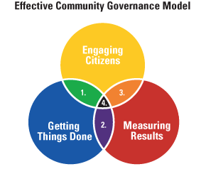
Community Governance Models
Governance Board
(Executive)
1 Community Problems Solving: Aligns “Engaging Citizens” and “Getting Things Done.”
2 Organizations Managing for Results: Aligns “Measuring Results” and “Getting Things Done.”
3 Citizens Reaching for Results: Aligns “Engaging Citizens” and “Measuring Results.”
4 Communities Governing for Results: Aligns all three core skills.
Institutional funders (MS, EC)
Stakeholders Forum
http://www.rtmteam.net/page.php?pageID=25&section=overview_of_ecg

Slide 12
EOSCPilot Governance Framework
Multi-layered
Multi-actored
Top-down and bottom up depending on context
Believed consistent with EOSC Declaration

Slide 13
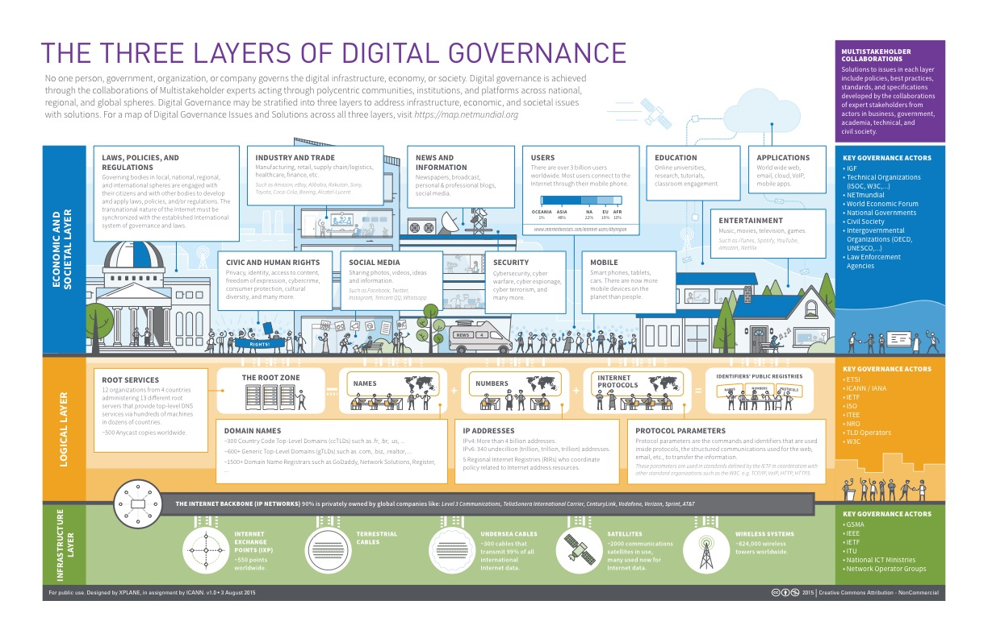
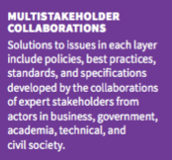
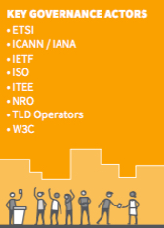
Digital Governance Ecosystem
https://www.icann.org/news/multimedia/1563

Slide 14
EOSC Governance Ecosystem
Research Community Layer
Key Governance Agency
Thematic Service Layer
Issues
Potentially useful view\infographic but…
Service centric not user driven
Assumes static roles – stakeholder play multiple roles
Key Governance Agency
Data and Content Layer
Key Governance Agency
e-Infrastructure Layer
Key Governance Agency

Slide 15
The Governance Framework
Governance Framework Grammar
outlines Engagement Mechanisms
needed to enable EOSC Stakeholders
to co-ordinate the Engagement Aspects
required to ensure interoperability within the Engagement Contexts,
according to the Actors’ Roles within the Supply Chain.
An Engagement Context governs multiple Processes
EOSC Stakeholders
European e-Infrastructures
Data/Research Initiatives
Cloud providers
Research funders
Cloud community
Research Communities and Institutions
Research Infrastructures (RIs)
Policy makers
Supply Chain Roles
Consumer\Researcher
Intermediary\Aggregator
Provider
Funder
Policy/Regulatory
Engagement Contexts
Legal\Policy
Organisational
Operational
Technical
Data\Information
Skills
Research challenges\agenda
Financial
Political
Engagement Aspects
Responsibility
Strategy
Acquisition
Performance
Conformance
Human behaviour
Engagement Mechanisms
Expert Group
Forum
Council
Board
Legal Structure
Governance Intent
Triplet defines who and their objective
Governance Structure
“Duplet” defines what needs to be achieved and how
A Governance Actor
is an implementation of a Governance Structure
in order to meet an Governance Intent

Slide 16
User Driven or User Agile
Researcher
Define Needs
Define Needs
Define Needs
Regulator
Funder
Define & Monitor Policies
Incentivise & Compensate
Define Needs
Aggregator
Define Needs
Define Needs
Define Needs
Provider
Provider
Provider

Slide 17
EOSC Model - Overview
Member States
Institutional
Market-driven
Interventionist
Monopolistic
Executive
“Other Resources”
“EOSC Compatible Resources”
“EOSC Compliant Resources”
“EOSC Managed Resources”
“Core Resources”
“Advisory” = Governance Ecosystem = Community

Slide 18
EOSC Model – Structures and Actors
Community Forums
EOSC
Funder Forums
Core
Member States – Institutional Forum
External Funders Forums?
Research Community Forums
Managed
Compliant
Provider Forums
Regulatory and Compliance
Compatible
Executive Board
Others?
External

Slide 19
EOSC Model: Responsibility Matrices
Community Forums
Funders Forums
Regulatory\
Compliance
 | Consumer | Aggregator | Provider | Funder | Regulatory
Legal\Policy
Organisational
Operational
Technical
Data\Information
Skills
Research challenges\agenda
Financial
Political
Responsible
Accountable
Consulted
Informed

Slide 20
Discussion

Slide 21
Discussion Topics
Should we try to accommodate Monopolistic, Interventionist and Market-driven economies within EOSC?
Does the model outline allow all three to coexist
How might the Stakeholder Forums self-organise
What are the more detailed Processes within the Engagement Contexts
What is the responsibility map from Processes to Stakeholder Roles

Slide 22
EOSC Governance Development Forum: egdf-secretariat@eoscpilot.eu To participate, register at: https://eoscpilot.eu/user/register

Slide 23
Policy/Process Area | Policy/Process | Process/Function/Task | Institutional (Oversight) Layer RACI | Executive/Operational Layer RACI | Advisory Layer RACI
Legal/policy | Rules of Engagement oversight | Enforcement of RoE
 |  | Development of RoE (i.e. amendments/new versions)
Organisational
Technical | EOSC Service Compliance
 | Quality Assurance (i.e. meeting required service standard for users)
Data/information | Data protection compliance
Skills
Research challenges/agenda | User requirements satisfaction (i.e. oversight of process for gathering and handling expression of user needs?)
Financial | Budget approval | budget model agreement
 |  | budget amounts agreement
 |  | etc
 | Budget oversight | e.g. Audit and Risk Committee | Sub-committee reporting to which layer of governance?
 | Accounts sign-off
Political

