Slide 1
Photon and Neutron Science Demonstrator
Notes:
The Photon Neutron Data Science Demonstrator will leverage on the photon-neutron community to improve computing facilities by creating a virtual platform for all users.
The Photon-Neutron science demo is based on the concept that:
* Data sets become too large to take home;
* The EOSC forms a platform for analysis and data storage
* The EOSC allows for easy data sharing
* Data rates require dedicated central IT infrastructure, way beyond previous requirements;
* A wide variety of scientific users means significant number of data formats and analysis software.
OBJECTIVES:
Exploiting a community of more than 35,000 unique users (in 2011), the science demo aims to enable cloud based storage and compute solutions, harmonize the privacy issues, foster standardized data formats and allow transparent and secure remote access to all data.
Facilitating a combined approach to neutron and photon data will enable 'new science'/new ways of analyzing and interpreting data across different methods.
Lowering the barrier to adoption and opening the data access will allow a broader scientific community to leverage the existing data.
In this presentation I will share the experience we have gained from the work on the science demonstrator and why it is important to simply just get started on using the many services out there.

Slide 2
Photon and Neutron Science Demonstrator
Images courtesy of the Paul Scherrer Institut https://www.psi.ch/niag/cultural-heritage
Notes:
But first:
How do we use Photo and Neutrons?
In our everyday life we are used to look at our surroundings in the visible spectrum of light.
We can crank up the frequency to get x-ray light, which will allow us to look right through stuff, superman style.
Using X-rays you can see heavy materials: metals, bone etc. but light elements and soft tissue becomes invisible.
Neutrons are different. They look through heavy element, such as metals, but allow us to see light elements such as biological material.
In this case the holy content inside the Buddha sculpture
Images courtesy of the Paul Scherrer Institut
https://www.psi.ch/niag/cultural-heritage

Slide 3
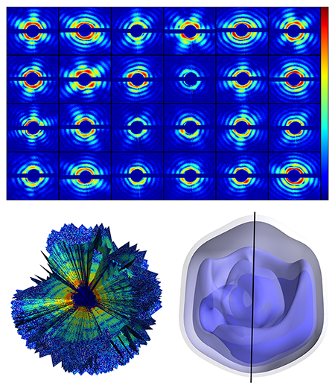
Photon and Neutron Science Demonstrator
Original Technical Focus:
Harmonize authentication and authorization – Shibboleth
Presumably indigo datacloud AAI. To be integrated at a late stage
Standardize data formats NeXus/HDF5 and annotation of data
Continuous process. HDF Product Designer would be interesting addition, but outside EOSC pilots
Allow transparent and secure remote access to data
Establish sustainable and compatible distributed data catalogues
ICAT
Allow long term preservation of data
Provide compatible data analysis software
Focus on container (docker, singularity)
Promote data policies in laboratories
Continuous process.
Tomas Ekeberg et al., “Three-Dimensional Reconstruction of the Giant Mimivirus Particle with an X-Ray Free-Electron Laser,” Phys. Rev. Lett. 114, 098102 (2015)
https://eoscpilot.eu/science-demos/photon-neutron-science-demonstrator
Notes:
When starting out we hade some ideas on what technologies to use. In order to try them out we took a specific workload (see diagram) and started on realizing it.
While some of the intermediate steps, like deploying on a local cloud was rather easily obtained, we quickly we found ourselves working to handle technical details stopping progress, eg. Issues with using dCache as a backend for OneData.
I believe this is a very important part of the science demonstrators: to identify barriers to adoption of various services.
Along the way we also changed what technologies to rely on, in order to get more progress.
This is a key lesson learned:
Get your feet wet!
In the current situation, where a lot of solutions exist, but few of them are canonical with broad adoptions don’t over analyse possible solutions.
Get started, apply a solution, see if it works out of the box, if not, try to fix it in a timeboxed manner, and if not working move onto another possible solutions.
On the next slide is an overview of how we see things today

Slide 4
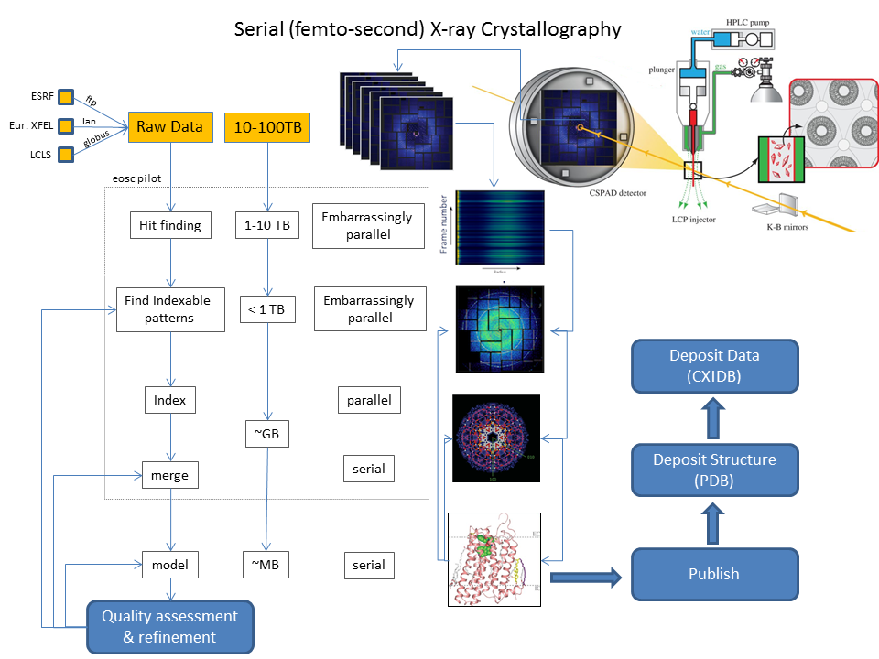
Photon and Neutron Science Demonstrator
Current Focus:
Select some challenging applications → CrystFEL
Huge Datasets but openly accessible
In parts embarrassingly parallel
Get applications ready for cloud
Virtual Images, Docker, Singularity (singularity.lbl.gov)
Establish data access
Transfer via curl from CXIDB (www.cxidb.org)
OneData (onedata.org)
Preferred: H5serv based distributed data access (www.hdfgroup.org)
Data publication
CXIDB repository See: Maia, F. R. N. C. The Coherent X-ray Imaging Data Bank. Nat. Methods 9, 854–855 (2012)
For related EUCALL-simulations: Zenodo
Re-organize data
Might need to shift from single- to multi-event layout
Notes:
Our current focus is to demonstrate the use of cloud services for a specific demanding analysis application (CrystFEL)
The raw data for this application (1—100TB) is so large they cannot easily be moved around. On the other hand, the first few steps are embarrassing parallel, allowing for WAN distributed processing.
We are looking at multiple ways to deploy including containers (Docker and Singularity) and more traditional virtual machines
Also to distribute the data we are looking into various solution, including the trusted curl, the more generic OneData and the dataformat specific HDF5 specialized H5serv
The final results can be published on the open CXIDB Coherent X-ray Imaging Data Bank.
In a related setup, the European Cluster of Advanced Laser Light Sources (EUCALL) is handling a complete simulation pipeline and plan to publish results on Zenodo.
As could be expected in order to take advantage of the embarrassingly parallel nature of the problem, the data needs to be organized in a way, that allow for efficient parceling out of data. More on this topic on the next slide.

Slide 5
Photon and Neutron Science Demonstrator
CrystFEL:
CrystFEL is a software suite created to address the processing needs of serial femtosecond crystallography (SFX).
See: https://doi.org/10.1107/S1600576716004751
Current versions support multi-event HDF5 processing
Enables efficient use of H5serv
Possible layouts for image data in a `multi-event' HDF5 file. (a) A three-dimensional array where one direction corresponds to image data. The correspondence between the dimensions of the array and the image data/frame number axes is arbitrary and can be defined by the user. (b) A tree of HDF5 groups, where each frame contains a simple two-dimensional array. (c) A combination of the two, where the file contains multiple three-dimensional blocks, each containing many frames of data. (d) A tree of HDF5 groups where the data for each of the two detector panels are stored in separate two-dimensional arrays.
Notes:
The application doing the analysis (CrystFEL) is supporting so-called multievent HDF5 processing, where more than one run is stored in the same data structure.
The internals of the data hierachy have multiple different possible layouts.
The important take away point here, is that details in how data are organized can be important for how to carry out the analysis in a distributed environment,

Slide 6
Photon and Neutron Science Demonstrator
Current Status:
New colleague@DESY (Michael Schuh for WP5)
Assisting in openstack issues and docker deployment
and at ESS (Kareem Galal)
Running the analysis from another environment
CrystFEL up and running in cloud environment
Improved application less likely to leave machines in an unusable state
As virtual image
As Docker in Cloud and (local) HPC farm
As Singularity in Cloud and (local) HPC farm
Setting up „community-docker-registry“ in progress; aim to support P&N AAI
Data pull via OwnCloud share
Dynamically via owncloud share API
Extract on CEPH store dynamically attached to instance
Speed isn‘t too impressive
OneData provider setup (still) in progress
HDFserver setup in progress
Data publication
CXIDB
Python convenience wrapper for Zenodo uploads
Notes:
Here is a brief overview of the current status.
+ there is a new resource at DESY working on the deployment and a resource at ESS looking at running the analysis as an outsider.
+ so far the work has made the application more robust and transferable to a number of cloud environments
+ On the data access also a number of options have been explored include owncloud, OneData and continued work on HDFserver
+ The Zenodo upload benefitted from convenience python wrappers.

Slide 7
Photon and Neutron Science Demonstrator
Next Steps:
Better Data Access
Finalize HDFserver and OneData setup
ICAT still under consideration, but postponed
Orchestration
Some ongoing work (non-EOSC) to have user friendly deployment of jobs across different systems (HPC/SLURM, Batch/HTCondor)
Some ongoing work (non-EOSC) for job-classification
Will be used/tested for CrystFEL later on
Community
P&N users/developers naturally don‘t care much
Very significant increase of Docker/Singularity usage
Spent some work (non-EOSC) to make Container deployment as simple as possible
Avoiding user namespaces through user certificates
Docker registries
Still low impact on cloud deployment; work in progress
Notes:
The coming months work will progress on data access and and orchestration.
There will also be work on uptake in the broader community.
+ most users of facilities don’t care much where the analysis is done, they just want to see their result
+ but we do see a significant uptake in the use of containters.
+ so barriers identified need to be addressed making container deployment as simple as possible for example
++ to handle the uid mapping between host an the image, a solution using local certificates was applied.
++ to make containers available they should be uploaded to relevant registries
+ Also deploying such containers on nonlocal infrastructure is currently not very common in the community.

Slide 8
Photon and Neutron Science Demonstrator
Conclusions so far
Lot of potential in existing cloud solutions
Devil in the detail: numerous small barriers to adoption
Cloud has to be at least as easy as local to be adopted
Science Demonstrators is a great way to identify improvement areas

