Slide 1
Governance Development Forum
Day 2
3 October 2017
Tallinn
Juan Bicarregui
STFC
Juan.bicarregui@stfc.ac.uk

Slide 2
Agenda
9:00-10:30
  EOSCpilot meets eIRG
  EOSCpilot and EOSC topics - Juan Bicarregui
  E-IRG Infrastructure Commons: interoperability and Integration - Arjen van Rijn
  Discussion
10:30-12:00
  Shaping the EOSC service architecture and service portfolio
  EOSC service architecture - Sergio Andreozzi
  EOSC service portfolio management – Jan Bot
  Discussion and wrap up Saara Kontro
12:00 Lunch

Slide 3
Governance Development Forum
Day 2
3 October 2017
Tallinn
Juan Bicarregui
STFC
Juan.bicarregui@stfc.ac.uk

Slide 4
EOSCpilot and EOSC topics
A tail of two decades
The first decade: 2003-2012
  Policy
  Some observations
The second decade (First half): 2013 -2017
  Policy
  Some observations
  EOSCpilot
The second decade (Second half): 2018-2022
  EOSCpilot isa pilot
  Some imaginations

Slide 5
The Policy Context
2003-2012
OECD, 2003-2006
Principles then Guidelines on Access to Research Data from Public Funding
EC, 2007-2012
Recommendation on access to and preservation of scientific information
G8+5, 2011-2012
Global Research Infrastructure Sub Group on Data
The views expressed herein are the personal views of the author and do not necessarily reflect the views of the policy makers

Slide 6
OECD 2003-2006: On Access to
Research Data from Public Funding
2003 - Science and Technology Ministers called on the OECD to develop a set of guidelines based on commonly agreed principles to facilitate cost-effective access to digital research data from public funding.
Declaration adopted on 30 January 2004
2006 - Recommendation of the Council concerning Access to Research Data from Public Funding
Principles and Guidelines endorsed by the OECD Council on 14 December 2006. [C(2006)184]

Slide 7
OECD Principles and Guidelines for
Access to Research Data from Public Funding
13 principles
A – Openness
Openness means access on equal terms for the international research community at the lowest possible cost, ....
B – Flexibility, C – Transparency, D – Legal conformity, E – Protection of intellectual property, F – Formal responsibility, G – Professionalism
H – Interoperability
Technological and semantic interoperability is a key consideration in enabling and promoting international and interdisciplinary access to and use of research data. ...
I – Quality, J – Security, K – Efficiency, L – Accountability
M – Sustainability
... taking administrative responsibility for the measures to guarantee permanent access to data that have been determined to require long-term retention.
[http://www.oecd.org/dataoecd/9/61/38500813.pdf]
(4 years of 20 has passed)

Slide 8
EUROPEAN COMMISSION 2007-2012
2007, Commission adopted a Communication and Conclusions on scientific information in the digital age
  access, dissemination and preservation
2010 Riding the wave: How Europe can gain from the rising tide of scientific data
  Final report of the High Level Expert Group on Scientific Data
2012 - COMMISSION RECOMMENDATION to member states on access to and preservation of scientific information
  Covers Publications, Data, and Infrastructure

Slide 9
G8+5 Global Research Infrastructure
Subgroup on Data report 2011
In 2020/2030…
Researchers and practitioners from any discipline are able to find, access and process the data they need in a timely manner.
They are confident in their ability to use and understand data, and they can evaluate the degree to which that data can be trusted. ...
Data are managed, shared, and preserved in a way that optimizes scientific discovery, innovation, and societal benefit. Where appropriate, producers of data benefit from opening it to broad access and routinely deposit their data in reliable repositories. A framework of repositories work to international standards, to ensure they are trustworthy...

Slide 10
G8+5 2012
Framework for Global Research Infrastructures.
Global scientific data infrastructure providers and users should establish an international forum for data interoperability. It should facilitate the exchange and interoperability of data across disciplines and national boundaries by producing high quality, relevant technical documents and procedures that influence the way researchers store, use, and manage data.
→ RDA

Slide 11
EOSCpilot and EOSC topics
A tail of two decades
The first decade: 2003-2012
  Policy
  Some observations
The second decade (First half): 2013 -2017
  Policy
  Some observations
  EOSCpilot
The second decade (Second half): 2018-2022
  EOSCpilot isa pilot
  Some imaginations

Slide 12
Aside: a Data centric view of open research (2007)
Virtual Research Environment
the researcher acts
through ingest and access
Archival
Data
Creation
Access
Services
Curation
Information Infrastructure
the researcher shouldn’t have to
worry about the information infrastructure
Network
Storage Compute

Slide 13
Data Sharing Vision
Single Infrastructure → Single User Experience
Data Analysis
Publications Catalogue
Different Infrastructures → Different User Experiences
Raw Data Catalogue
Analysed Data Catalogue
Publication Data Catalogue
Raw Data
Data Analysis
Analysed Data
Publication Data
Publications
Experiment 1
Raw Data
Data Analysis
Analysed Data
Publication Data
Publications
Observation 2
Raw Data
Data Analysis
Analysed Data
Publication Data
Publications
Simulation 3
Capacity
Storage
Software
Repositories
Data
Repositories
Publications
Repositories

Slide 14
EOSCpilot and EOSC topics
A tail of two decades
The first decade: 2003-2012
  Policy
  Some observations
The second decade (First half): 2013 -2017
  Policy
  Some observations
  EOSCpilot
The second decade (Second half): 2018-2022
  EOSCpilot isa pilot
  Some imaginations

Slide 15
The Policy Context 2013 -2017
  G8 Ministerial Communiqué, 2013
    “… [publically funded] scientific research data should be open…”
  [EC Communication and OSTP Memo 2013]
G7 Ministerial Communiqué, October 2015
  “…accomplish an effective open-data science environment at the G7 level and beyond.”
EC Communication on European Cloud Initiatives, April 2016
  EOSC
    Summit (June 2017)
    Declaration (~Oct 2017)
    Roadmap (~Dec 2017)

Slide 16
G8 Ministerial Communiqué:
London, 2013
Antimicrobial Resistance
Open Access to Publications
Open Data:
To the greatest extent and with the fewest constraints possible publicly funded scientific research data should be open, while at the same time respecting concerns in relation to privacy, safety, security and commercial interests, whilst acknowledging the legitimate concerns of private partners.
Open scientific research data should be easily discoverable, accessible, assessable, intelligible, useable, and wherever possible interoperable to specific quality standards.
To maximise the value that can be realised from data, the mechanisms for delivering open scientific research data should be efficient and cost effective, and consistent with the potential benefits.
To ensure successful adoption by scientific communities, open scientific research data principles will need to be underpinned by an appropriate policy environment, including recognition of researchers fulfilling these principles, and appropriate digital infrastructure.

Slide 17
G7 Ministerial Communiqué
Berlin Oct 2015
Neglected tropical diseases
Future of the Seas and Oceans
Global Research Infrastructures (GRIs)
  “…[4 items about Global (physical) Research Infrastructures]…
  Further progress on sharing and managing scientific data and information should be achieved, especially by continuing engagement with community based activities such as the Research Data Alliance RDA.
  We encourage the GSO to continue their work on convergence and alignment of inter-operable data management that could accomplish an effective open-data science environment at the G7 level and beyond.”
Clean Energy

Slide 18
“An Open-data
Science Environment”
The European Open Science Cloud:
Open (Open-Science) Cloud & Open (Science-Cloud)
Science includes research in all domains, public and private
Cloud virtualised, transparent, service-oriented commons
Relates to EC Communication: A Digital Single Market Strategy for Europe:
European Free flow of data initiative
Seamless, interoperable digital services
Digital ecosystems of hardware, software, applications and data
Removing technical and legislative barriers to data driven science
Enabling new services for data-driven science through open systems and services and cross-border flow of data
Data as a catalyst for economic growth and innovation
A transition towards more efficient Open Science

Slide 19

Why Europe is not fully tapping into the potential of data:
Data not always open and lack of incentives and rewards for data sharing
Lack of interoperability required for data sharing … noting deep-rooted walls between disciplines.
Fragmentation between data infrastructures that are split by scientific and economic domains, countries and governance models
Surging demand for High Performance Computing at a scale above single member state resources
Data reuse employing advance analysis techniques adequate protection of personal data considering forthcoming revision of Copyright legislation.

Slide 20
To develop EOSC it will be necessary to:
Make all scientific data produced by the Horizon 2020 programme open by default.
Raise awareness and change incentive structures for academics industry and public services to share their data.
Develop specification for interoperability and data sharing across disciplines and infrastructures
Create a fit-for-purpose pan-European governance structure to federate scientific data infrastructures and overcome fragmentation.
Develop cloud based services for Open science supported by the necessary data infrastructure
Enlarge the scientific user base to researchers and innovators from all disciplines.

Slide 21
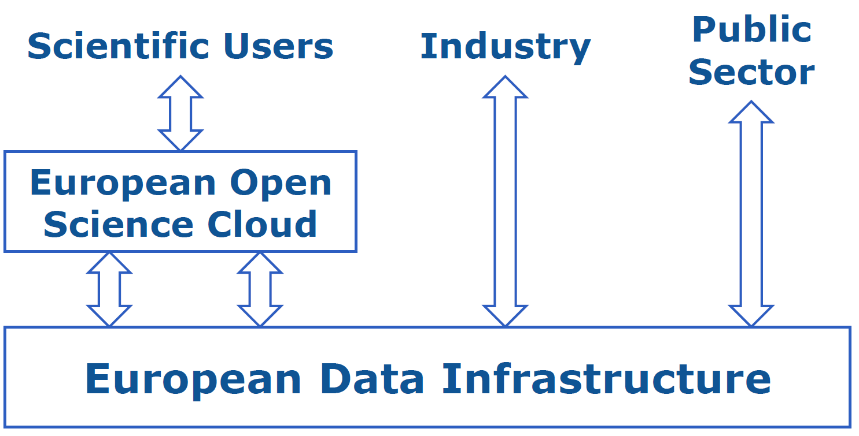
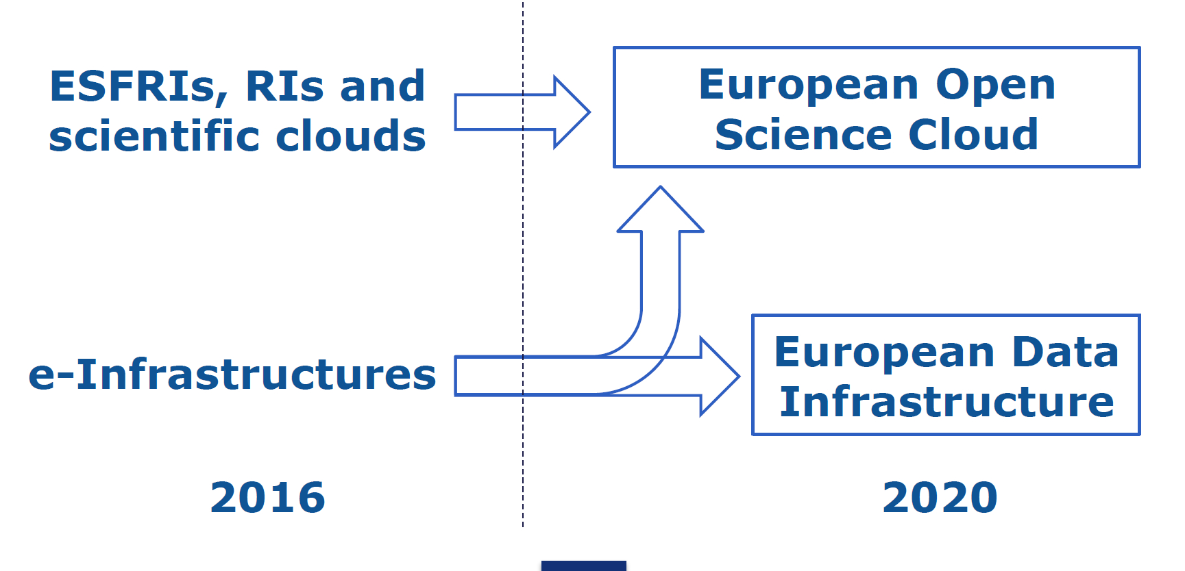
Evolution of infrastructure
Virtual Research Environment
Information Infrastructure
Diagram: Augusto BURGUEÑO ARJONA
Services
Curation
Network
Storage Compute

Slide 22
EOSCpilot and EOSC topics
A tail of two decades
The first decade: 2003-2012
  Policy
  Some observations
The second decade (First half): 2013 -2017
  Policy
  Some observations
  EOSCpilot
The second decade (Second half): 2018-2022
  EOSCpilot isa pilot
  Some imaginations

Slide 23
Horizontal and Vertical
How do we integrate and share Domain Specific and Horizontal e-Infrastructures?

Slide 24


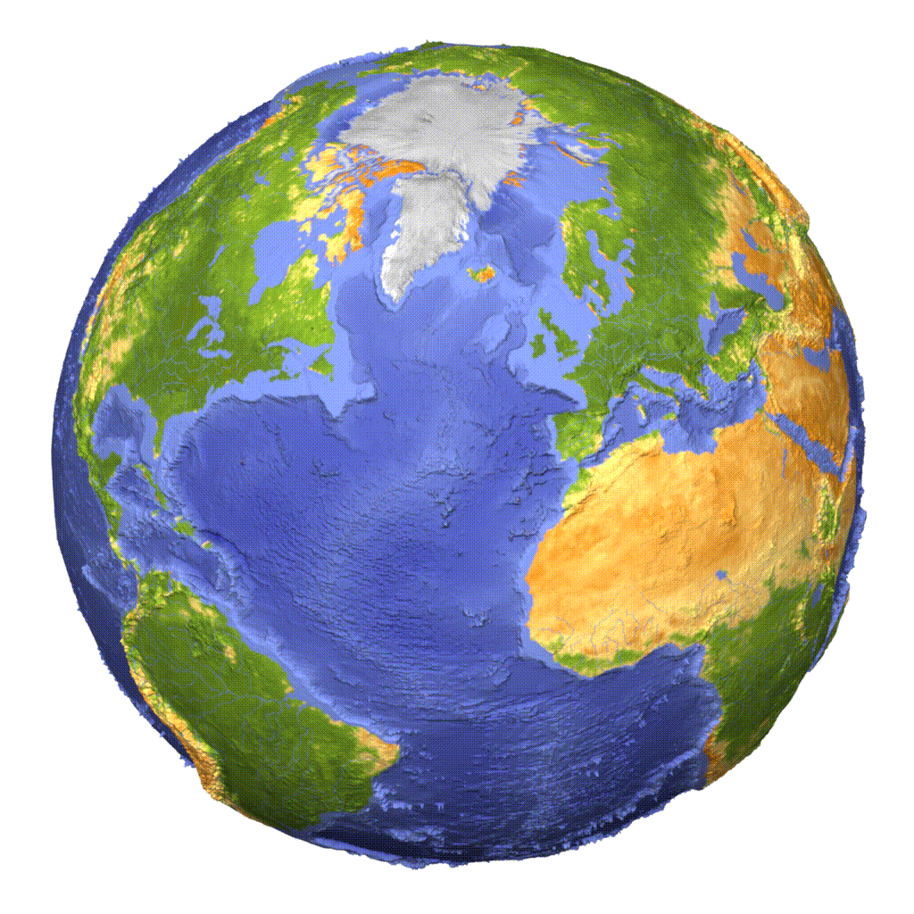
“Building Bridges”
From RDA Plenary 1
2013
Bridges to the future
  data preservation
Bridges to research partners
Bridges across disciplines
Bridges across regions
Bridges to integration
Two types of bridges we can build:
Connecting Data
Connecting People
What kind of organisation do we need to do this?

Slide 25
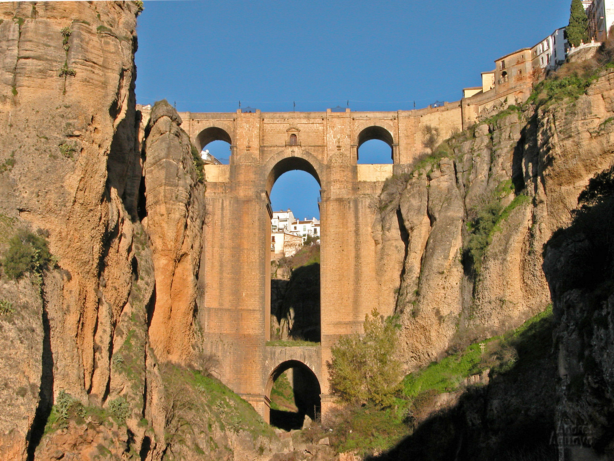
Notes:
First one out of sequence so wont say when (1750-1793)
Note the Strong vertical integration!
Small horizontal elements –
but confident – they put a room on top!

Slide 26
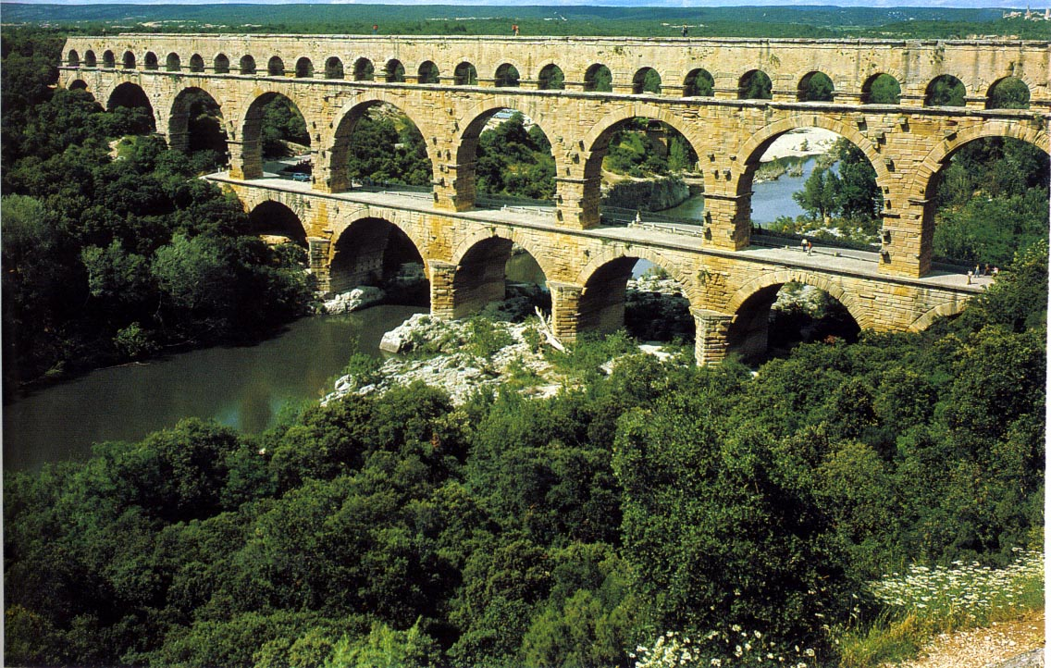
Notes:
Pont du Gard, 50km
Also 1st Centuary
Gradiant 1:3000 (bin 500m of bridge part)

Slide 27
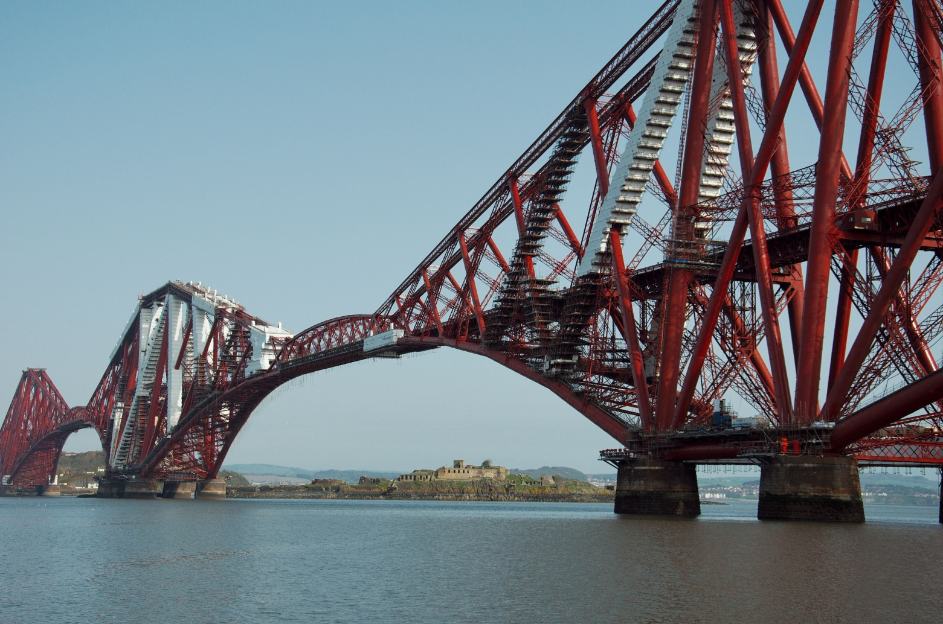
Notes:
Another 300 years – 1890 Firth of Forth (edinburgh)
New materials, new technolgy – new design – self standing pilars reach out with small bridging pieces

Slide 28
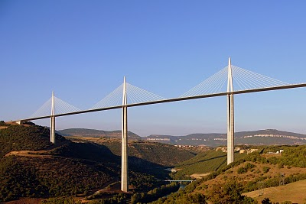
Notes:
2004 milau – only horizontal – vertical just to make horizontal possible - Refer to horizontal elements
Metaphors for data exchange and for RDA communities and for RDA organisation.
b

Slide 29
EOSCpilot and EOSC topics
A tail of two decades
The first decade: 2003-2012
  Policy
  Some observations
The second decade (First half): 2013 -2017
  Policy
  Some observations
  EOSCpilot
The second decade (Second half): 2018-2022
  EOSCpilot isa pilot
  Some imaginations

Slide 30
EOSCpilot: High Level Aims
The EOSCpilot project will support the first phase in the development of the EOSC. It will
Establish the governance framework for the EOSC and contribute to the development of European open science policy and best practice;
Develop a number of demonstrators functioning as high-profile pilots that integrate services and infrastructures to show interoperability and its benefits in a number of scientific domains;
Engage with a broad range of stakeholders, crossing borders and communities, to build the trust and skills required for adoption of an open approach to scientific research.
(More detailed objectives later)

Slide 31
EOSCpilot Partners
33 Partners, 15 Third Parties (+subcontractors and unfunded)
Domain specific research infrastructures providers, projects and clusters
  STFC, EMBL, MPG, INFN, INGV, DESY, DANS, ICOS, INAF, BBMRI, ESS, BGS, XFEL, ERCIN and CERN.
Horizontal e-Infrastructure providers
  CSC, SURF, CNRS, JISC, PRACE, BSC, GEANT, CEA, CINECA, EGI and LIBER.
    (Projects EUDat, Indigo-DataCloud, EGI-Engage, AARC, and OPENAire+ )
Research performing and support organisations
  EGI, UEDIN-DCC, LIBER, TRUST-IT, ARC, CNR, DANS, KIT, UEDIN, UGOE, UMAN, PIN and BGS
Research Funding Organisations
  STFC, SURF, CNRS and CNR
More to be added later

Slide 32
Workpackage Level Objectives
Governance Objective.
To design and trial a stakeholder-driven governance framework …
Policy Objective.
To establish the policy environment required for the effective operation…
Science Demonstrators Objective
To develop a number of Science Demonstrators … to drive the development of the EOSC.
Services Objective
To create a number of EOSC pilot services that federate data, infrastructure and services …
Interoperability Objective
To define and implement specifications, interfaces, standards and processes that …underpin interoperability and sharing …
Skills Objective.
To develop common standards and assessment frameworks to ensure …
Community Engagement Objective.
To identify and bring together … the major groups of stakeholders …
Notes:
Gov, pol,demo,serv,inter,skill,community
10,10,25,20,20,5,10

Slide 33

EOSCpilot Challenges
Three types of challenges addressed by the EOSCpilot:
Scientific Challenges: deploying the EOSC to deliver Open Science
Scientific Challenges are really Opportunities
Technical Challenges: developing technical solutions that meet the scientific needs
Technical Challenges are Barriers to overcome
Cultural Challenges: adopting new, more open ways of working
Cultural Challenges are also Barriers

Slide 34
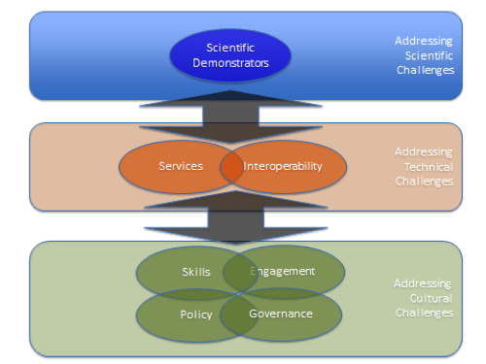
Workpackage Challenges
Now
Later Today
Yesterday

Slide 35
Science Demonstrators
Provide requirements for EOSC technologies
Evaluate whether Services from EOSC meet science needs
15 science demonstrators in 3 groups of 5
  12 month each
  Starting 6 months apart

Slide 36
First 10 Science Demonstrators
Environmental & Earth Sciences - ENVRI Radiative Forcing Integration to enable comparable data access across multiple research communities by working on data integration and harmonised access
High Energy Physics - WLCG: large-scale, long-term data preservation and re-use of physics data through the deployment of HEP data in the EOSC open to other research communities
Social Sciences – TEXTCROWD: Collaborative semantic enrichment of text-based datasets by developing new software to enable a semantic enrichment of text sources and make it available on the EOSC.
Life Sciences - Pan-Cancer Analyses & Cloud Computing within the EOSC to accelerate genomic analysis on the EOSC and reuse solutions in other areas (e.g. for cardiovascular & neuro-degenerative diseases)
Physics - The photon-neutron community to improve the community’s computing facilities by creating a virtual platform for all users (e.g., for users with no storage facilities at their home institutes)
Energy Research – PROMINENCE: HPCaaS for Fusion - Access to HPC class nodes for the Fusion Research community through a cloud interface
Earth Sciences – EPOS/VERCE: Virtual Earthquake and Computational Earth Science e-science environment in Europe
Life Sciences / Genome Research: Life Sciences Datasets: Leveraging EOSC to offload updating and standardizing life sciences datasets and to improve studies reproducibility, reusability and interoperability
Life Sciences / Structural Biology: CryoEM Workflows: Linking distributed data and data analysis resources as workflows in Structural Biology with cryo Electron Microscopy: Interoperability and reuse
Physical Sciences / Astronomy: LOFAR Data: Easy access to LOFAR data and knowledge extraction through Open Science Cloud

Slide 37
EOSCpilot and EOSC topics
A tail of two decades
The first decade: 2003-2012
  Policy
  Some observations
The second decade (First half): 2013 -2017
  Policy
  Some observations
  EOSCpilot
The second decade (Second half): 2018-2022
  EOSCpilot isa pilot
  Some imaginations

Slide 38
EOSCpilot isa pilot
EOSCpilot is just a pilot – it will not build the EOSC
  A pilot not a design study
  A set of experiments and design proposals
  A requirements study?
Must feed into and work with future RI and eI projects….
EOSC calls:
    March 2017 - EINFRA-12 (EOSC-Hub, Openaire, ….)
    March 2018 – INFRAEOSC 1,4,5
    March 2019 – INFRAEOSC 2,5,6

Slide 39
WP 2018-20 – INFRAEOSC Programme
Implementing the EOSC (2019-2022)
INFRAEOSC-01-2018:
  Access to commercial services through the EOSC hub
  Mar 2018 (1*€12M)
INFRAEOSC-02-2019:
  Prototyping new innovative services
  January 2019 5*~ €5M
INFRAEOSC-04-2018:
  Connecting ESFRI infrastructures through Cluster projects
  March 2018 (CSA) n* €1.5-2M where n = 3…12
INFRAEOSC-05-2018-2019:
  Support to the EOSC Governance
  April 2018 2* €10M (Goverance and Fair) + 5* €6 (RIA - coord)
INFRAEOSC-06-2019-2020:
  Enhancing the EOSC portal and connecting thematic clouds
  March 2019 1*2m

Slide 40
Timing of Projects

Slide 41
EOSCpilot and EOSC topics
A tail of two decades
The first decade: 2003-2012
  Policy
  Some observations
The second decade (First half): 2013 -2017
  Policy
  Some observations
  EOSCpilot
The second decade (Second half): 2018-2022
  EOSCpilot isa pilot
  Some imaginations

Slide 42
Horizontal and Vertical
The EOSC merges what are Domain Specific and Horizontal e-Infrastructures…..
DANGER
Resources and Data
Shared across RIs and eIs

Slide 43
Science
Reusable
Assesable
Data
Intelligible
Services
Bio
Medicine
Environment
Social Sci
Network Storage Compute
Physical Sci
Dicoverable Accessable
Humanities
Notes:
Pont du Gard, 50km
Also 1st Centuary
Gradiant 1:3000 (bin 500m of bridge part)

Slide 44
EOSCpilot and EOSC topics
A tail of two decades
The first decade: 2003-2012
  Policy
  Some observations
The second decade (First half): 2013 -2017
  Policy
  Some observations
  EOSCpilot
The second decade (Second half): 2018-2022
  EOSCpilot isa pilot
  Some imaginations

Slide 45
Governance Development Forum
Day 2
3 October 2017
Tallinn
Juan Bicarregui
STFC
Juan.bicarregui@stfc.ac.uk

Slide 46
Agenda
9:00-10:30
  EOSCpilot meets eIRG
  EOSCpilot and EOSC topics - Juan Bicarregui
  E-IRG Infrastructure Commons: interoperability and Integration - Arjen van Rijn
  Discussion
10:30-12:00
  Shaping the EOSC service architecture and service portfolio
  EOSC service architecture - Sergio Andreozzi
  EOSC service portfolio management – Jan Bot
  Discussion and wrap up Saara Kontro
12:00 Lunch

Slide 47
Governance Development Forum
Day 2
3 October 2017
Tallinn

Slide 48
Agenda
9:00-10:30
  EOSCpilot meets eIRG
  EOSCpilot and EOSC topics - Juan Bicarregui
  E-IRG Infrastructure Commons: interoperability and Integration - Arjen van Rijn
  Discussion
10:30-12:00
  Shaping the EOSC service architecture and service portfolio
  EOSC service architecture - Sergio Andreozzi
  EOSC service portfolio management – Jan Bot
  Discussion and wrap up Saara Kontro
12:00 Lunch

Slide 49
Data Culture and Services
Sections 1 and 2 of Declaration:
Data Culture and FAIR Data
Research data services and Architecture
[Governance and Funding]

Slide 50
Data Culture and FAIR data
This section has 15 Paragraphs:
1. [Data culture]
…research data is recognised as a significant output of research…
2. [Open access by-default]
All researchers must enjoy access to an open-by-default, ….
3. [Skills]
The necessary skills and education … should be provided throughout the EU as part of higher education,
4. [Data stewardship]
Researchers need the support of adequately trained data stewards. …
5. [Rewards and incentives]
Rewarding research data sharing is essential….

Slide 51
Data Culture and FAIR data
[FAIR principles] Implementation of the FAIR principles must be pragmatic and technology-neutral, …
[Standards] The EOSC must be underpinned by minimal and rigorous global standards for open research data …
[FAIR Data governance] The design and implementation of FAIR principles must be built upon inclusive stakeholder participation …
[Implementation & transition to FAIR] Implementation of FAIR principles requires careful prioritisation and orchestration. …
[Research data repositories] Trusted research data repositories play a fundamental role in modern science.

Slide 52
Data Culture and FAIR data
[Accreditation/certification] Scientists must be assured that the …research infrastructures where they deposit/ access data conform to clear rules and
[Data Management Plans] … the use of DMPs should become obligatory in all research projects generating or collecting publicly funded research data
[Technical implementation] …researchers also need handy tools to make data FAIR. These include:
    [Citation system]
    [Common catalogues]
    [Semantic layer]
    [FAIR tools and services]
[Data expert organisations] The Research Data Alliance, CODATA, DDI Alliance and other organisations active in the research communities must be used as forums to reach …
[Legal aspects] It is essential for the success of EOSC to clarify and address the legal uncertainty of Open Access to research data, …

Slide 53
Data Culture and Services
Sections 1 and 2 or Declaration:
Data Culture and FAIR Data
Research data services and Architecture

Slide 54
Services and Architecture
This section has 11 Paragraphs:
1. [EOSC architecture] The EOSC will be developed as a data infrastructure commons …
2. [Implementation] Resources, components and initiatives of pan-European relevance will be federated on the basis of objective criteria, …
3. [Legacy] The EOSC should incentivise the re-use of existing building blocks…
4. [User needs] Users should see the EOSC as a one-stop-shop to find, access, and use research data and services from multiple disciplines and platforms. …
5. [Service provision] Research Data Infrastructures, e-infrastructures and commercial operators will develop and provide services based on user needs, …
6. [Service deployment] The EOSC shall support different deployment ….

Slide 55
Services and Architecture
7. [Thematic areas] The EOSC shall promote the co-ordination and progressive federation of open data infrastructures developed in specific thematic …
8. [Research infrastructures] The role of ESFRI and EIROFORUM research infrastructures and organisations in the EOSC will be enhanced, …
9. [EU-added value and coordination] The EOSC must implement policy hand in hand with technology. …
10. [High Performance Computing and the EOSC] … This supercomputing and data infrastructure could support the European Open Science Cloud by providing data access and advanced computing and data management services. ...
11. [Innovation] The EOSC should create a level playing field for businesses and innovative SMEs to develop, and co-develop with publicly funded institutions, added-value services for researchers. …

Slide 56
Governance Development Forum
Day 2
3 October 2017
Tallinn

