Slide 1
EOSCpilot All Hands Meeting, Pisa, 8-9 March, 2018

Slide 2
WP8: Session on FAQs Magdalena Getler, University of Edinburgh Päivi Rauste, CSC

Slide 3
EOSC pilot FAQs
How do we deliver a great experience that reflects EOSC brand? How do we show that we listen to our stakeholders?
questions must echo real concerns people have
language must reflect the vocabulary and phrasing of our stakeholders
well-managed FAQs will show that EOSC is listening and addressing people’s concerns
Why do we need FAQs?
Make the most of data available (social media, fora, blogs, events, SEO)
“FAQs must be reserved for frequently asked questions since that’s the only thing that makes an FAQ a useful website feature”: Yes or No?
Helpdesk facility, contact us, web forms. What else?

Slide 4
Website analytics: what does it tell us?
The most viewed content:
/Events
/Science Demonstrators
/About

Slide 5
Development of FAQs
Information design
chunk by topic so people can rule out most topics quickly
good information design can help people locate what they need and discover other information they may want
Set the tone
any conversation with the stakeholders should be polite, personable and reflective of EOSC brand (guidelines?)
FAQs are public -> serve as indicators of how easy it is to resolve problems and find a helpful person to talk to

Slide 6
FAQ characteristics
welcoming
clear-cut
well-organized (e.g. answers visually distinctive from questions)
up-to-date
credible
language reflects the vocabulary and phrasing of our stakeholders

Slide 7
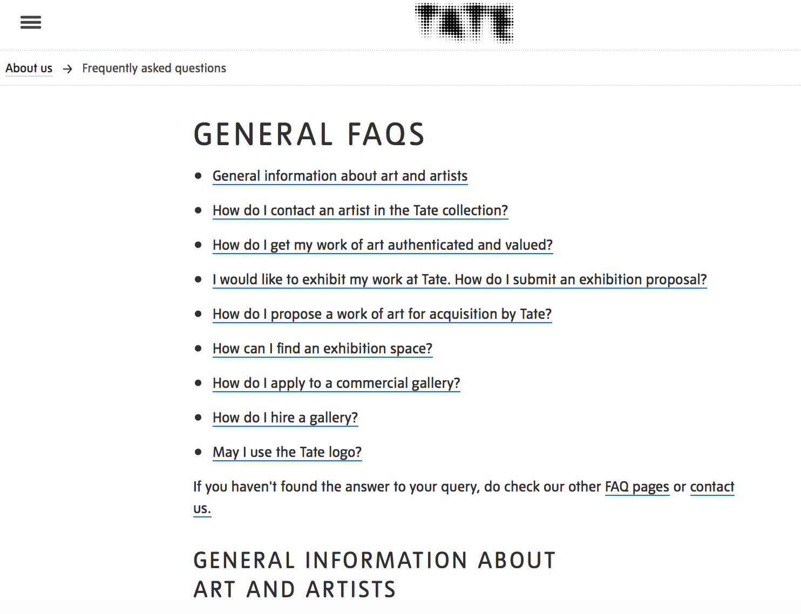
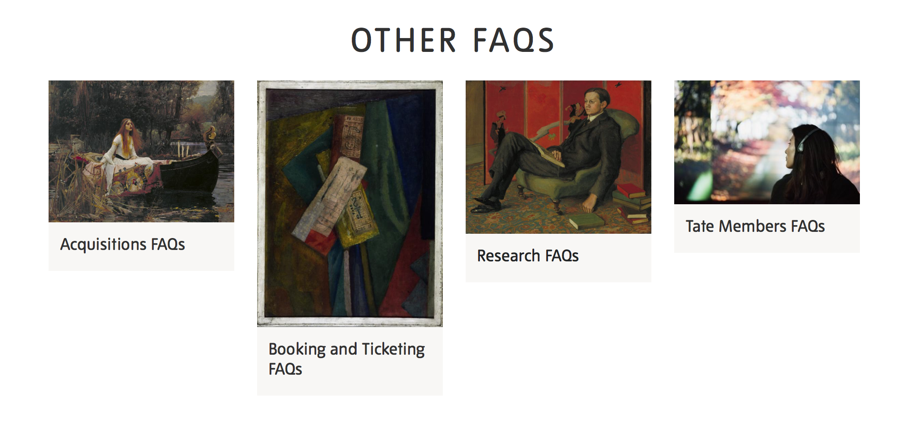
Good and bad FAQs: examples

Slide 8
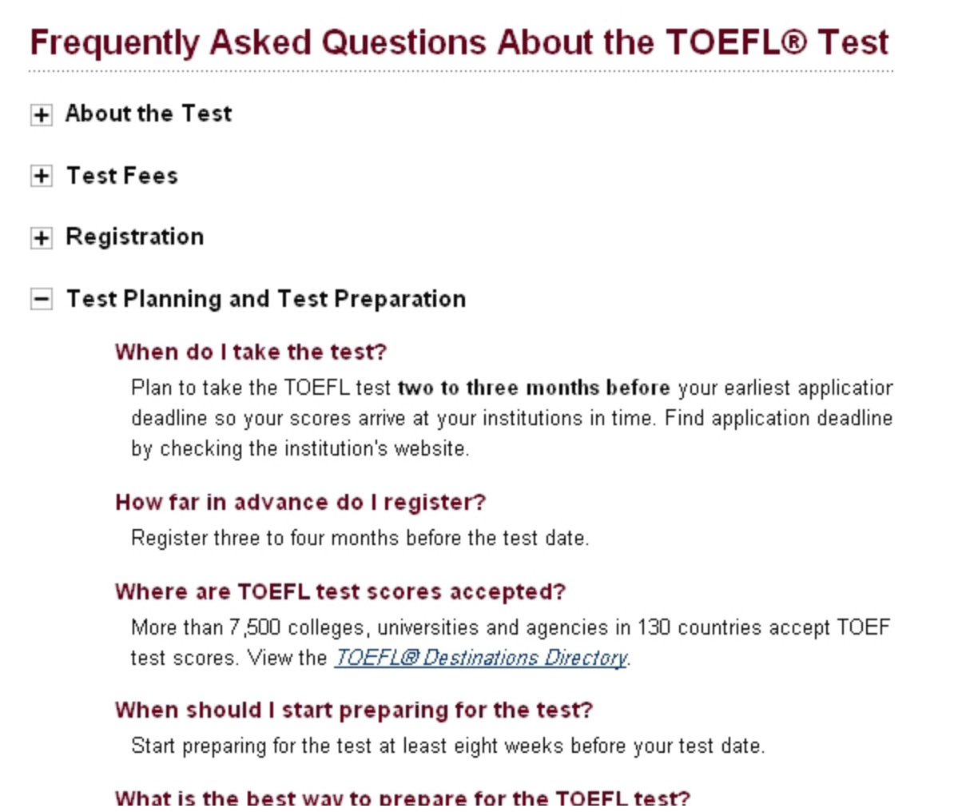
Good and bad FAQs: examples

Slide 9
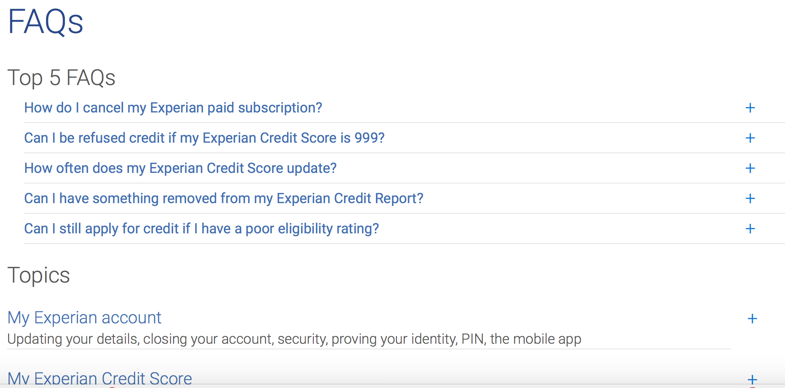
Good and bad FAQs: examples

Slide 10
Discussion
QA: how do we ensure FAQs are credible, helpful & up-to-date?
What process should be followed for creating FAQs?

Slide 11
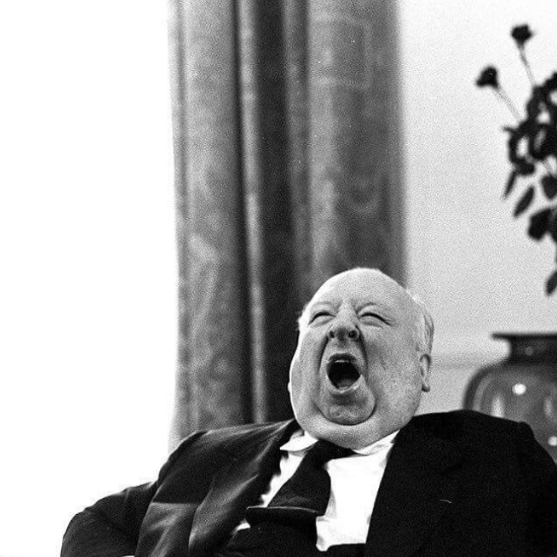
Exercise
Drafting answers to FAQs

Slide 12
Thank you

