Slide 1
Services: Update & discussion
Jan Bot
Jan.Bot@SURFsara.nl
03/10/2017

Slide 2
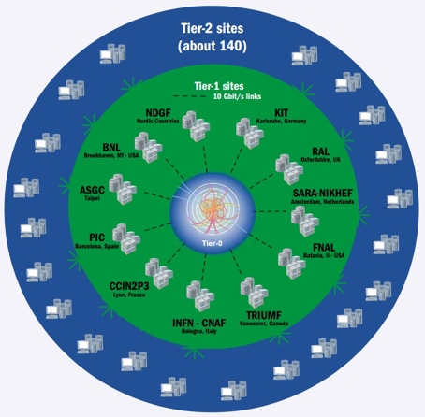
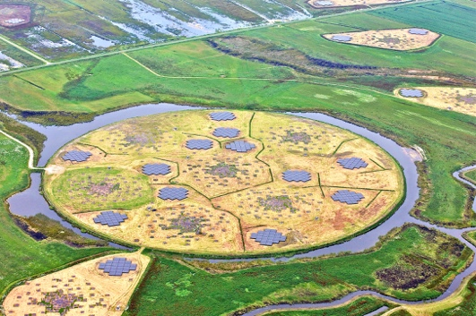

EOSC examples (?)
WLCG
WLCG
Human Brain Project

Slide 3
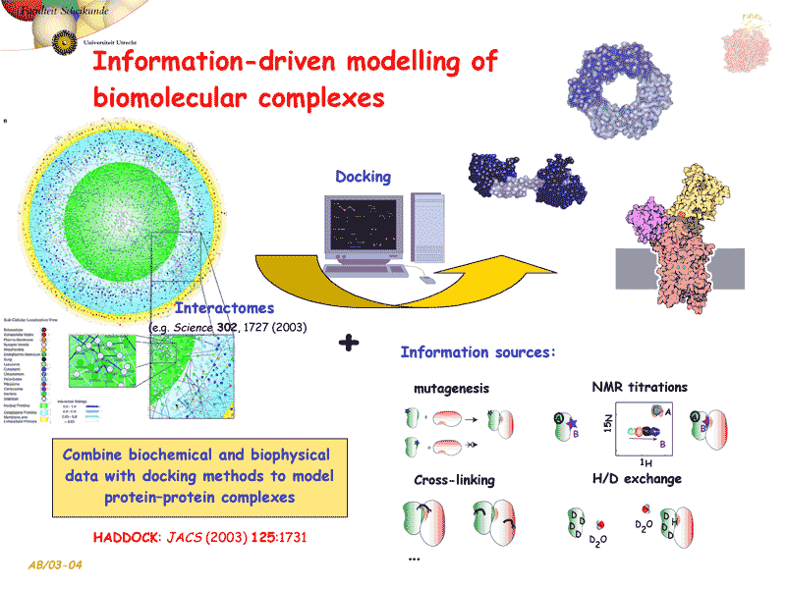


We-NMR & MoBrain collaboration
International community supported by a variety of resource
providers
  INFN-PADOVA (Italy)
  RAL-LCG2 (UK)
  TW-NCHC (Taiwan)
  SURFsara (The Netherlands)
  NCG-INGRID-PT (Portugal)
  NIKHEF (The Netherlands)
  CESNET-MetaCloud (Czech Republic)
Yearly 75M core hours & 50 TB storage

Slide 4

National infrastructure access
Service | Max cpu request | Max storage request | User support | Delivery Model | Request through
Cartesius | 30M SBU | 100s of TBs | 4 hours*
LISA | 3M SBU | 200 GB per user | 4 hours*
HPC Cloud | 70K core hours | 2 TB | 4 hours
Grid | 4M core hours | 200 TB disk, 250 TB tape | 250 hours
Big data services | - | 25 TB | 4 hours
* Separate funding opportunities available for code optimisation
B2C, Apply as individual
B2C, Apply as project
B2B, Institutional subscription

Slide 5
Reasons for reluctant adoption of e-infra services by RIs
Lack of confidence in provided service
  Service longevity
  Service stability
  Lack of clear SLA
Mismatch in requirements
  Service scalability
Lengthy acquisition process
…
→ translate into requirements for EOSC portfolio inclusion

Slide 6
Service Portfolio Management
The purpose of a Service Portfolio is to understand, both internally and externally, what services an organisation provides. This is necessary for effective service management as much of it is arranged and managed by service. A Service Portfolio also help create an internal awareness within the organisation of the concept of a ‘Service’ from an ITSM point of view, rather than a more technology orientated point of view (which tends to refer to Service Components as Services).
The Service Catalogue is a customer view of the same set of information, showing potential customers what services are available. This aligns the internal and external view on what customers are offered, which eases customer relationship management.

Slide 7
Some EOSC portfolio principles
Be as inclusive as possible
  No service left behind
Describe rather then threshold service levels
  Service consumers can determine what service level is acceptable
Implement light-weight portfolio management processes
  In line with expected impact of the service
Flexible delivery model
  Sponsored services, pay-as-you-go, …

Slide 8
System-of-systems & service stacking
RI provider
RI – e-Infra collaboration
Long tail
E-infra provider
[S|D]aaS
?aaS
PaaS
IaaS

Slide 9
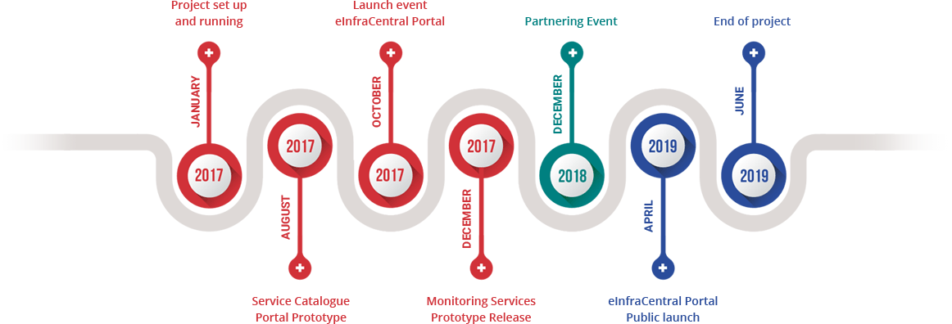
EOSCpilot portfolio & similar initiatives
e-InfraCentral
  Service template & service descriptions
  Publication platform (being developed by eIC)
  Service update methodology (shared activity)
MERIL
  Mapping the European RI landscape
  Currently over 900 infrastructures and 2000 services added
Elixir
  Defined portfolio and rules of engagement

Slide 10
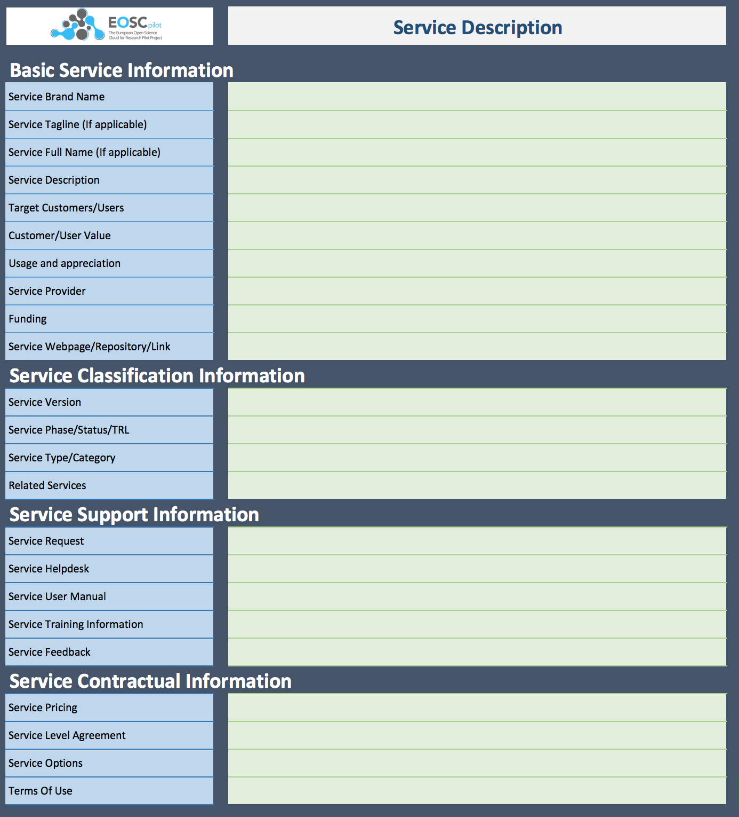
Describing (existing) services: Service description template
Service description template e-InfraCentral & EOSCpilot

Slide 11

Service description status
EGI, EUDAT, GÉANT, OpenAIRE, PRACE
  Service descriptions should arrive soon
GÉANT cloud catalogue
  Dimension Data
  Cloud Sigma
ICOS
  ICOS Carbon Portal
LTER
  DEIMS
SeaDataNet
  SeaDataNet
SINE2020
  e-neutrons.org
ASTERICS
  12476 data resources & services
PIN
  ARIADNE Portal
4TU
  4TU.ResearchData
DANS
  DataverseNL
  EASY
  Narcis
Nikhef
  NDPF (compute, storage,
  co-location & peering)
Bonvin lab
  HADDOCK
  CPORT
  DisVis
  PowerFit
  Prodigy
  SpotOn
  3D-DART
  WHISKY
SURFsara
  Cartesius (HPC)
  LISA (HTC)
  IaaS Cloud (HTC)
  Grid (HTC)
  Big data infra (Hadoop, Spark)
  Visualisation
  Swift
  BeeHub
  Data archive
  Data ingest
  PID service
  Jupyter
  Consultancy
  Training
RUG
  …

Slide 12
Service providers
Discipline
Specific
Aspecific
ICOS, LTER, SINE2020, …
EGI, EUDAT, GÉANT, PRACE, OpenAIRE
European
Regional
DANS
NGIs, NRENs, …
Institutional
Research groups, …
Local IT

Slide 13
Some observations
It’s all about data
Vertical integration is commonplace
Large role for local / regional institutes (first line of support)

Slide 14
Other inputs
Output of EUDAT H2020 T4.1: inventory of IT needs of European projects
  Final report will be available end of October
eInfra Central (template & platform)
  Template (small revision is coming up)
  Service descriptions of major EU e-infrastructure providers
Request records of infrastructure providers
  Aggregation of regional request information

Slide 15
What are communities & researchers asking for?
Individual users
  Cloud (I/PaaS) resources
  Data sharing facilities
Research Infrastructures
  Support
  Data sharing facilities
  Analysis platform

Slide 16
















Standardisation versus support
standardisation
support
International
National
Local

Slide 17
Service delivery triangle
Infrastructure diversification
e-infrastructure provider
Long tail of science
Standardisation
Service level agreements
Support
Community specific services
Support
Research
Infrastructure
End-user

Slide 18
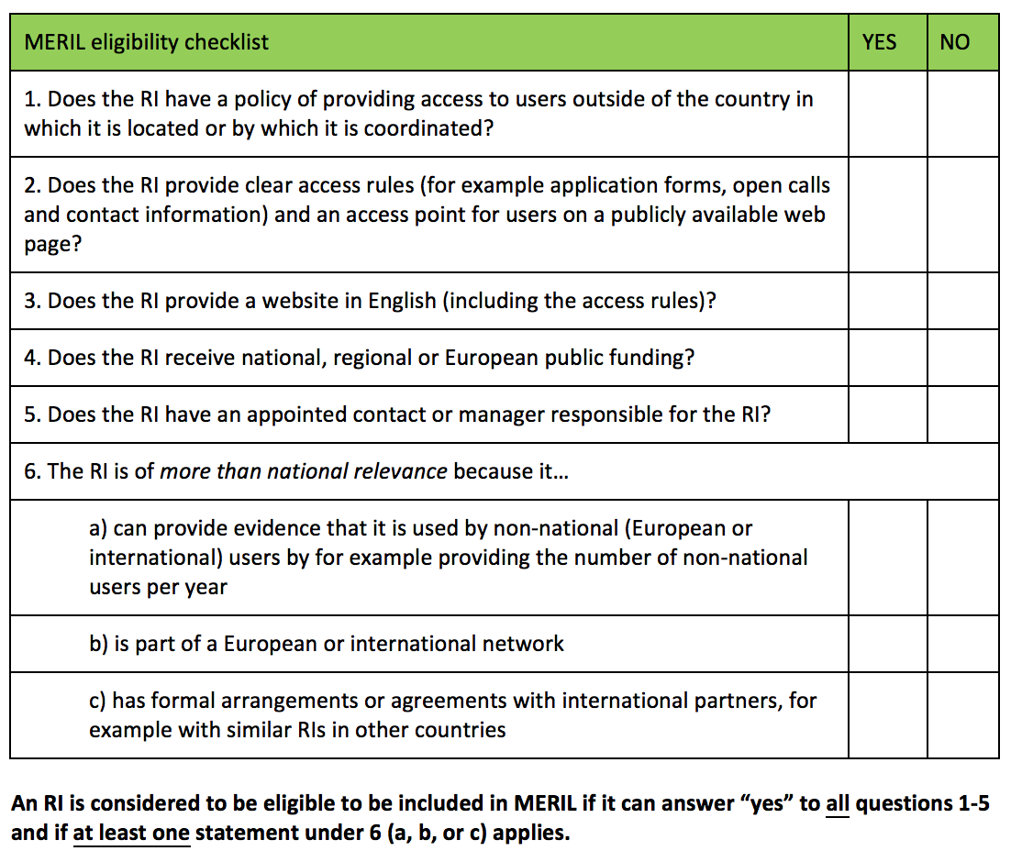

MERIL: rules for entering the portfolio
MERIL self-assessment form

Slide 19
Elixir: Portfolio processes
1. SAB Review
The proposed Node-funded services are included in the Node Application and reviewed by the ELIXIR SAB.
The ELIXIR Board approves the Node Application upon recommendation by the ELIXIR SAB.
2. Submission
Based on a template and the Node Application, the Hub prepares a draft Service Delivery Plan (SDP).
Node & Hub review the SDP and agree on it.
3. Approval
SDP is approved by the ELIXIR Board, signed by the Node and attached as Annex 1 to the Node Collaboration Agreement .
4. Monitor & Control
The Collaboration Oversight Group monitors the implementation of the SDP.
Also, the Node controls if changes in the SDP are required and requests them to the Hub.
The full process for submitting and accepting ELIXIR Services consists in four steps

Slide 20
EOSC Model – Overview
How to translate into portfolio?
Member States
Institutional
Executive
“Other Resources”
“EOSC Compatible Resources”
“EOSC Compliant Resources”
“EOSC Managed Resources”
“Core Resources”
“Advisory” = Governance Ecosystem = Community

Slide 21
Task goals
Gather community input
  Needs & wants wrt ‘underlying’ services in EOSC
  Terms & conditions (expectations) for including their services
Portfolio management
  Describe basic requirements & procedure to enter the portfolio
  Define update & removal policies
  Set intervals for portfolio reviews

Slide 22
Discussion
How do we deal with ‘non-infrastructure’ services such as consultancy, training & support?
Should we include services in the EOSC portfolio that are ubiquitous throughout the member states?
How do we ensure MS funding without burdening users with lengthy request procedures?

Slide 23
Jan Bot
Jan.Bot@SURFsara.nl

