Slide 1
European
Open Science Cloud
All Hands Meeting
WP3 Plenary Session
Pisa, 8-9 March 2018

Slide 2
WP3: Policy engagement
P. Tsiavos, E. Papadopoulou, G. Papastafenatos, N. Manola – Athena RC
D. Robertson, M. Dovey, L. Mack - Jisc
E. Dijk, R. Thorat - DANS
Ch. Ohmann – Univ. of Dusseldorf
S. Battaglia - ECRIN, P. Holub, M. Mayrhofer - BBMRI
P. Rouse – GEANT, F. Molnár-Gábor – Univ. of Heidelberg
V. Cavalli – LIBER, J. Hyppola – CSC, P. Manghi, E. Lazzeri - CNR

Slide 3
WP3 – Objectives and structure
Build a European policy framework for EOSC
to be used in rules/principles of engagement & governance
Provide tools for
recording policies (machine readable solutions)
monitoring OS policy implementation
Engage stakeholders ensuring that all requirements are met
Notes:
Aiming Research Infrastructures (RIs), Research Performing Organisations (RPOs), Research Funding Organizations (RFOs)

Slide 4
WP3 – Where we are
WP3.1 Policy Engagement
D3.1 Policy Landscape Review (M12)
D3.3 Draft Policy Recommendations (M16)
D3.6 Final Policy Recommendations (M22)
WP3.2 Policy Supporting Services
D3.2 Specifications for an European Open Science Monitor Service (M14)
D3.4 Specifications for Open Science Registry (M18)
D3.5 Open Science Policy Toolkit (M20)
Notes:
State here that the weight is on Year 2.
Year 1 had only the PLR (D3.1)

Slide 5
Policies in EOSC: the overall picture
Policies
The ground rules
Rules of Engagement
Structure of (binding) interactions
Governance
Internal coordination & decision making
Provide concrete set of recommendations based on drivers and constraints
Structure interaction with actors, service providers, consumers, public & commercial players …
Reflect decisions for the operation of EOSC as a primary mechanism for delivering open science policies

Slide 6
WP3.1 Policy engagement
Notes:
In terms of the methodology followed for the completion of the Policy Landscape Review, we performed a comprehensive desk research of the key EU policy areas relevant to the EOSC ecosystem starting from horizontal policies and then gradually making a transition to more specific sectoral policies related to Open Science. Our approach took as its starting point the importance of reducing frictions and removing barriers for the free flow of knowledge in the EU, while at the same time providing systems of incentives for those seeking to open their research results.
See Note 40 ee Janez Potočnik (2007) The EU’s Fifth Freedom: creating free movement of knowledge, SPEECH/07/257, Informal Competitiveness Council, Wuerzburg (Germany), 26 April 2007

Slide 7
Key activities
Harmonisation of EU policies with respect to EOSC
Prioritisation of EOSC policy areas
Analysis of drivers and constraints to produce policy recommendations for different types of stakeholders (….. RPOs, RFOs, RIs)

Slide 8
1. Positioning EOSC in the landscape of EU policies
IoT
Platforms
Open Innovation
Robotics
Standards
Open
Open to the world
DAE/ DSM
Digitising European industry
Open Science
Confidentiality
Europe 2020
ECI (EOSC)
IPR
Patents
ERA
Data Economy
Copyright
Language (TDM)
Skills
Cultural
PSI
Geodata
Personal Data
Stats
Macro policies
Notes:
Focus on ECI -> Digitising European industry + Data Economy and the three arrows leading to Open Innovation, Open Science, Open to The World
The EOSC concept covers not only technological infrastructure but, as part of the ECI, is a manifestation of the broader ecology of open science in Europe ranging from infrastructures and data to services and skills, that seeks to build a globally competitive data and knowledge economy in Europe.

Slide 9
2. Priorities for EOSC : a matrix of policies
Infrastructure and services
Free flow of data
Data & open science skills
Public procurement
In the context of
Paying attention to
Data Economy
Digitising European industry
IPR
Personal Data
PSI
…as they are key to implementation for data
and information/ content flow
For
Open Science, Open Innovation, Open to the world

Slide 10
First result: high level recommendations
Produce consistent policies at the EU, the Member State and the institutional level
Standardise interactions at the organisational and institutional (micro) level
Focus on the interactions with the industry, where the greater inefficiencies currently exist
Focus on interactions with platforms in order to maximize value, protect data ownership and portability and avoid vendor lock-in
Automate the application of policies supporting open science by design and default, as well as data sovereignty for the user
Support the development of the e-infrastructures services that could use the EU GDPR as a competitive advantage

Slide 11
3. Policy recommendations (ongoing)
Open Science & Open Scholarship
FAIRness of research outputs, data stewardship, RDM, Metrics, IPR, Access policies for interfaces & services
Data Protection, assurance and ownership
Geodata, IPR, data privacy, licensing regimes
Procurement
What type of EOSC resources, at what levels, which rules/regulations to follow
Ethics
EOSC in need of ethics related services. Where to embed? Clear need for special skills and training
Micro policies aimed at RPOs, RFOs, RIs

Slide 12
Example: FAIR research outputs
Research infrastructures
Constraints: Technical limitations, undefined user, unclear level of FAIR for data, infrastructure or services Drivers: Transparency, increased efficiency, the ability of EOSC users to work with a large-scale, dynamic infrastructure that spans multiple scientific domains
Funders/Ministries
Constraints: Lack of coordination between various FAIR related activities Drivers: Return on investment in FAIR, including skilled reviewers in the funding panels or train the reviewers in RDM , institutions can check the DMP , financial incentive to “open” the data at the end of the project? (scary APC model for data)
Research Performing Organisations (including Libraries)
Constraints: data sets re-use Drivers: libraries to create FAIR datasets to be re-used by researchers, offering DOI/PIDs services, systematic review services could include research data and make the re-use of data visible , monitoring and communicating the (re-) use of data-sets, enabling re-use by providing infrastructure (repositories, linked data, interfaces, identifiers, etc.)
Help shaping EOSC principles and rules of egagement
Map to OSPP discussions and recommendations

Slide 13
Next steps
D3.1 - Policy landscape and prioritization
D3.6 - Final Policy Recommendations
2018
Dec
April
Oct
Open Consultation and validation
D3.3 - Draft Policy Recommendations

Slide 14
WP3.2 Policy supporting services

Slide 15
Policy supporting tools/services
Policy is key to EOSC, so supporting tools are considered as core services
Policy toolkit
Open Science policy registry
Open Science Monitor

Slide 16
1. Policy toolkit
Collection of resources, tools, and approaches, supporting the management of various policy issues
Addresses different stakeholders
What it will deliver: a directory of resources, with some classification for stakeholder and intended use
When: August 2018
Work so far: A big list of resources gathered in landscape reviews of D3.1 and D3.2
Potential collaboration with FORCE11 Scholarly Commons/ Decision Trees group

Slide 17
2. Open Science Policy Registry
An EOSC wide registry of open science machine-readable policies used
as a service for users to assess EOSC compliance and compatibility, and
as a reporting tool to produce metrics on the progress of open science in Europe.
What it will deliver: requirements and specifications for machine readable policies, specifications for registry, development of a prototype
When: Specifications in June 2018
Work so far: Started reviewing PASTEUR4OA specifications
Notes:
too much text. Make bullets

Slide 18
3. Open Science Monitor
A set of services to measure levels of compliance with open science policies of any science resources
research artefacts, educational resources, research collaboration, citizen science
What it will deliver: landscape efforts, OSM framework, requirements and specifications for service implementation
When: Feb 2018, revision to be expected
Work so far: D3.2 under internal review

Slide 19
OSM work so far (D3.2)
1. Identify OS components
2. Landscape of existing efforts
3. Define targets for EOSC
5. Develop OSM Framework
4. Map to indicators
To be completed
+ Service specification
…leading to OpenAIRE Open Science Observatory

Slide 20
OS components: what to measure
Open Science Monitor
Open source software
OA to publications
Open educational resources
Data and OS skills
Open peer review
Open citations
Citizen science
FAIR data

Slide 21
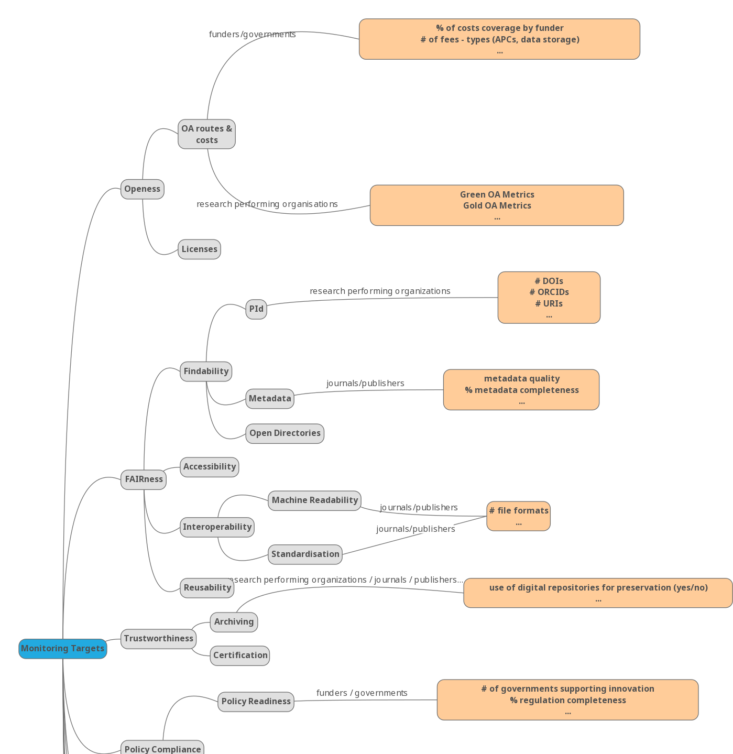
How to measure: monitoring targets & indicators
Openness
FAIRness
Trustworthiness
Policy Characteristics - preparedness; adoption; compliance
Transparency in OPR and Dissemination in citations
Open Education impact and Open Educational Resources uptake
Open Science Expertise and Training uptake
Citizen engagement and societal impact
Economic impact
Research impact and excellence

Slide 22
Next steps
pending internal review
D3.2 - Specifications for an European Open Science Monitor Service
D3.5 - Open Science Policy Toolkit
Open Consultation and validation
2018
March
June
Aug
prototyping
D3.4 Specifications for Open Science Registry

Slide 23
User engagement

Slide 24
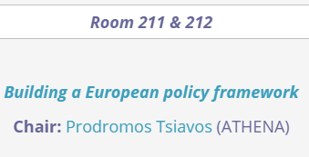
WP3 engaging with stakeholders
Two hands-on workshops

Slide 25
Next steps
Engage with the broader community
External experts for 3.1 on policy recommendations
Open Consultation for OS Monitor
Further interaction with EOSCpilot partners
Webinars and workshops
OpenAIRE NOADs
FORCE11 groups
GOFAIR assessing tools
…

Slide 26
In summary: Outcomes and Achievements
Outcomes | Achievements
EU policies Mapping | Elucidation of the EU policy landscape and understanding of its relationship with institutional and organisational policies
High level policy recommendations | Concrete and workable suggestions in relation to the improvement of EU policies on Open Science
Review of policy monitoring initiatives | Understanding, clarification and presentation of the core policy monitoring initiatives and mechanisms in order to advance them into their next stage of development

Slide 27
Thank you!

