Slide 1
WP5.2 Report & outlook Jan Bot, SURF

Slide 2
Task 5.2 EOSC Service Portfolio
Service Portfolio Management
The purpose of a Service Portfolio is to understand, both internally and externally, what services an organisation provides. This is necessary for effective service management as much of it is arranged and managed by service. A Service Portfolio also help create an internal awareness within the organisation of the concept of a ‘Service’ from an ITSM point of view, rather than a more technology orientated point of view (which tends to refer to Service Components as Services).
Inclusion criteria
Removal criteria
Update criteria

Slide 3
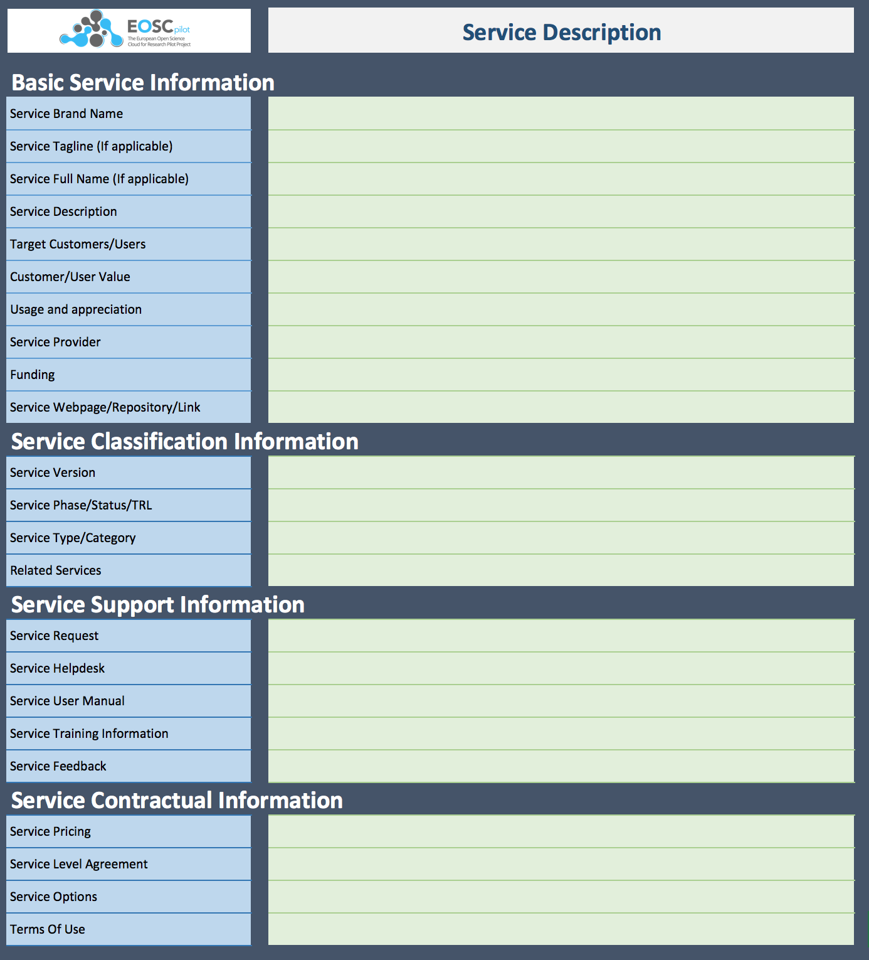
WP5.2 Results
Collaboration with eInfraCentral
Sharing of service descriptions
Adoption of eInfraCentral Service Description Template
Gather input on service requirements from science demonstrators
In collaboration with T5.1, T5.4 and WP6
Description of services of project partners
Description of Service Portfolio Management (SPM) methodologies of project partners
First design of EOSC SPM process
More detailed description of output available in D5.2 “EOSC Service Portfolio”
Notes:
Collaboration with eInfraCentral meant a shift in the task’s objectives.

Slide 4
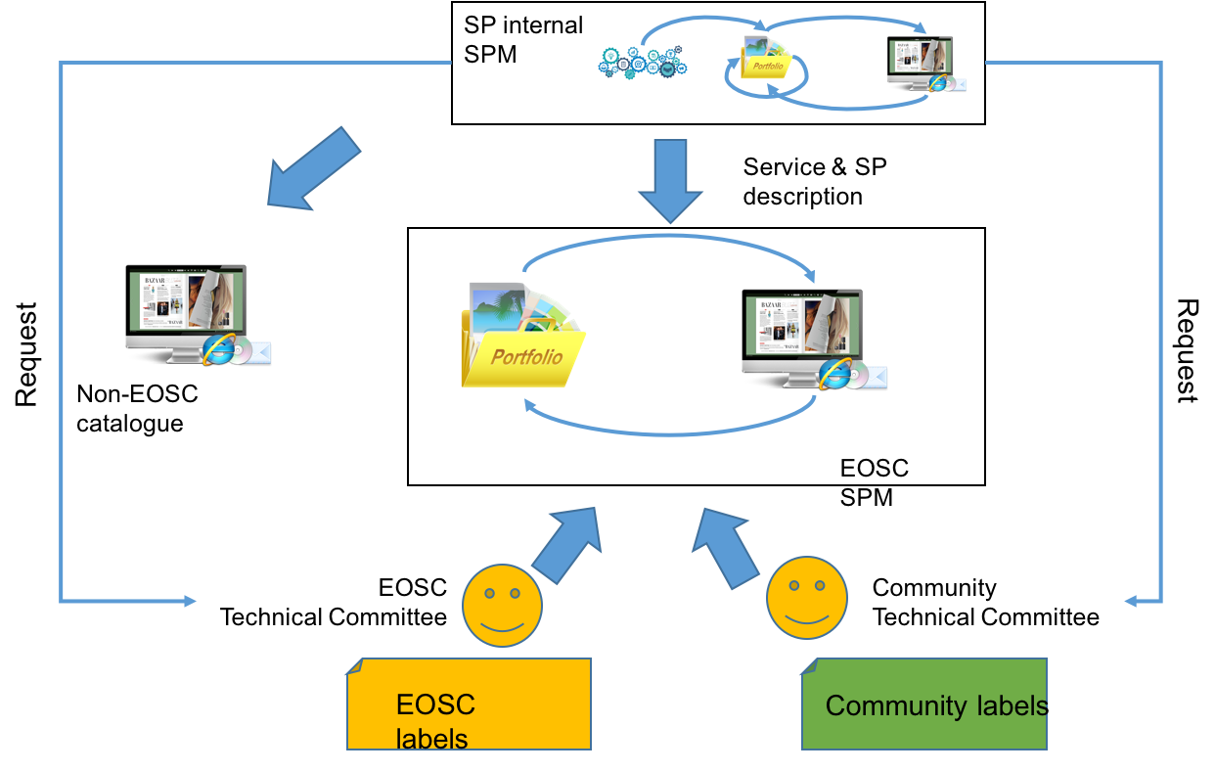
Service Portfolio Management: Challenges and first design
Federated setting: augment existing ITSM frameworks with EOSC specific processes when needed.
Provider heterogeneity: provide multiple levels of EOSC ‘compliance’ and ‘compatibility’ to be able to include providers with various maturity levels.
Consumer heterogeneity: enable communities / scientific disciplines to define their own set of requirements and provide the ability to label services according to their needs.
Service quality vs. inclusiveness: allow various levels of service quality but make sure services are properly described
Notes:
Structure of slide is Challenge: proposed solution.

Slide 5
EOSC Portfolio Process

Slide 6
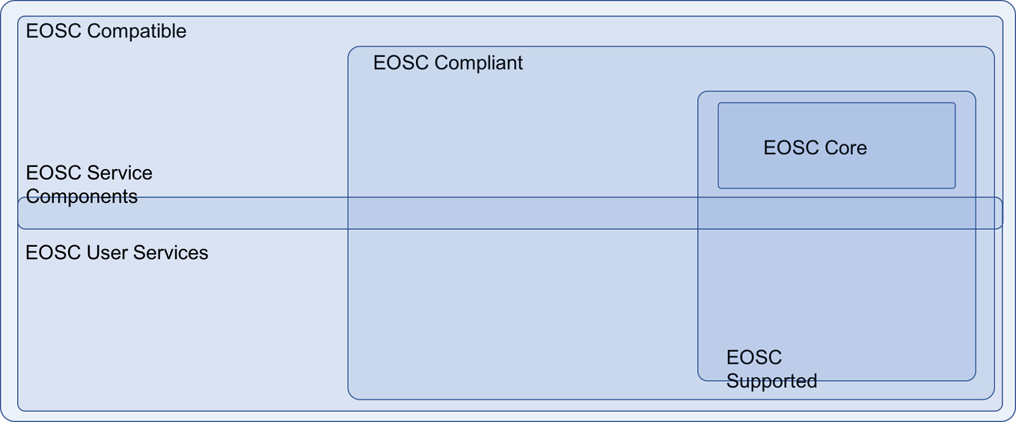
EOSC Service Categories
Service status:
EOSC Compatible: minimal requirements set by principles of engagement
EOSC Compliant: adherence to a more strict set of requirements posed by EOSC
Service sponsoring
EOSC Supported Services: Services that are commissioned and therefore financially supported by EOSC.
Service types & audience
Core Services: the fabric on which the EOSC is built, includes e.g. AAI, monitoring and accounting services.
Service components: e-infrastructure and software components that can be combined to create end-user services.
End-user services: services that are directly accessed by scientists
Notes:
Important to realise that services can be part of multiple categories, as shown in the Venn diagram.
Service status: how well does a service ‘fit in’ to EOSC?
Service sponsoring: how is a service being financed?
Service types & audience: who / what is the intended user of a service?

Slide 7
Service Portfolio: Minimal requirements
Provide service & service provider descriptions
Only include actively supported services
Provide access route for international users
Be compliant with EU rules and regulations

Slide 8
WP5.2 Issues
Diversity of stakeholders and services: limit initial work to ‘core services’ and work outwards from there
Circular project dependencies: bootstrap initial EOSC model and iteratively refine original setup
Community involvement: organise discussion sessions and face-to-face meetings

Slide 9
WP5.2 Future work
Determine what the ‘core services’ are and specify their functionality
Specify (in collaboration with other tasks) what the rules of engagement are for the various service categories are
Identify what service components are

Slide 10
Service abstraction levels
Type: indicating what functionality is to be expected. This can e.g. be an AAI service, for which you would expect it to provide a method to authenticate users from various sources
Implementation: a software system that implements the required functionality as specified by the service type. This can e.g. be the GÉANT AAI system.
Instance: a service implementation offered by a service provider at a particular moment in time. This could be an instance of the GÉANT AAI system currently running at SURFnet.

Slide 11
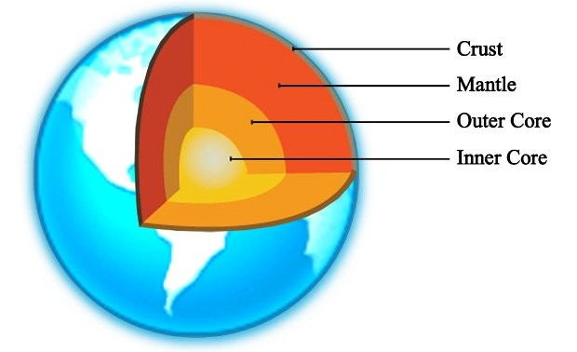
Remodelling the layers
Inner core
All services to make EOSC work as a system
Service types are dictated by EOSC
Validity of service implementations is checked by EOSC
Development of services is coordinated and funded through EOSC
EOSC aims to limit the amount of service implementations & instances to make operation of these services more efficient and cost effective.
The providers of service instances are required to be certified against international standards and make themselves available for auditing
Service providers receive base level compensation for offering these services
Services in other layers that aim to be EOSC compliant are required to use one of the EOSC approved instances of a service that provides the required functionality.
Outer core
Mantle
Crust

Slide 12
Remodelling the layers
Inner core
Outer core
Services that e.g. RIs can use to build their own platform on. Consists mainly of e-infrastructure services.
Offer a uniform interface to service providers to be able to easily scale-up or move operations
Create synergy between service providers by
Providing specialised services to a wider demographic that would otherwise not be economically viable
Provide services that require cross provider collaboration (e.g. a cross- data-center data replication services)
Facilitate knowledge sharing between service providers by focusing on a limited set of technologies that are used across the EOSC
Service types include (but are not limited to): Cloud compute, object storage, networking, PID systems, etc.
EOSC aims to standardise the interfaces that these service implementations expose (e.g. S3 object protocol, OAI-PMH).
Mantle
Crust

Slide 13
Remodelling the layers
Inner core
Outer core
Mantle
Non-scientific discipline specific higher-level services.
Aim of this layer is to:
Guide the development of software platforms (implementations) that can be instantiated by various service providers.
To standardise on a limited number of platforms and protocols to facilitate data and tool re-use across disciplines.
To build on top of the interfaces as exposed by the outer core services.
Service types include (but are not limited to): scientific gateways, VREs, web-platforms, analysis engines, etc.
Examples of service implementations: D4Science, Catania Science Gateway, Galaxy.
To be EOSC compliant, these service implementations are required to interface with inner core services where applicable.
These service implementations are encouraged to build on top of outer core service interfaces, which will contribute to their EOSC compatibility.
These services can be part of the EOSC Supported Services (for which funding is available to develop or run the service) but don’t have to be.
Crust

Slide 14
Remodelling the layers
Inner core
Outer core
Mantle
Crust
All end-user facing services.
Aim of this layer is to:
Provide scientists with fit-for-purpose services
Service types: can roughly be anything IT infrastructure related.
Can be instantiated outer core or mantle services, but don’t have to be.
To be EOSC compliant, they are required to use inner core services where applicable.
Services in this layer will, in the most part, be provided by RIs and will be geared towards specific scientific communities.
These services could be made available to the ‘long tail of science’ as well, but that can probably better be done on a national, regional or local level (which is also where the funding for these types of services is).

Slide 15
Questions & discussion
Input on layer model?
One approach for all service types doesn’t seem to work: focus on ’core services’ and work out from there?
This does imply less (no?) work on higher level services
Core services discussion, which services to include:
In: Accounting, Monitoring, …
Out: AAI, …
How should quality and inclusiveness be balanced? Should / can we rely on the RIs to define their own inclusion criteria?
Now mainly focussing on inclusiveness
Relationship between RIs and e-infrastructures: are e-infras ’just’ service providers or collaboration partners?
This influences how services are offered and presented

Slide 16
Timeboxing
Inner core service types and implementations need to be identified and agreed on before the end of this year.
Inner core service provider requirements (including required certification) need to be identified and agreed on before the end of this year.
Funding methodology for inner core services must be established before the end of this year.
Outer core service types and implementations need to be identified (inventoried) before the end of this year.
Make a start with interface analysis of outer core and mantle services.
Everything else is considered to be out of scope for the remaining period of EOSCpilot.
As for the broader EOSC setting: priority should be given to get instances running for every inner core service type. That will give EOSC partners something to work with and show concrete results.
Once the inner core services are established, outer core services can be added to the mix.

