Slide 1
WP5 “Services”

Slide 2
Outline
Key Results
Task reports
Achievements
Future plans
Issues
Conclusions

Slide 3
WP5 Key results
Requirement gathering, validation of results through service pilots
Overall Architecture
Service portfolio and its management process
Federated Service management
Roles, processes and policies
T5.2
T5.1
T5.2
T5.4

Slide 4
T5.1 EOSC Overall Architecture (Lead: CNR)
Objectives
Develop & evolve the overall EOSC architecture (“system of systems” approach)
Identify the key components and services and relations among them

Slide 5
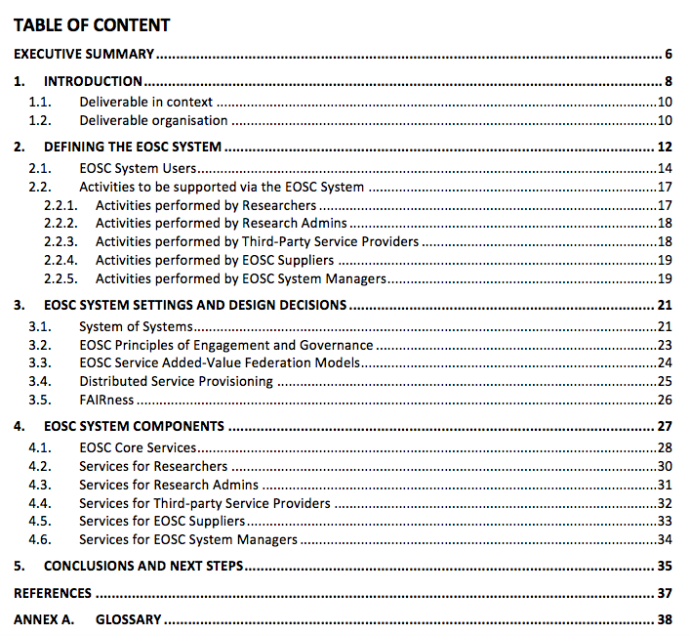
Methodology and Outputs
D5.1 Initial EOSC Service Architecture
Clarify the context (who and what)
Identify the typology of key components of architecture and EOSC services

Slide 6
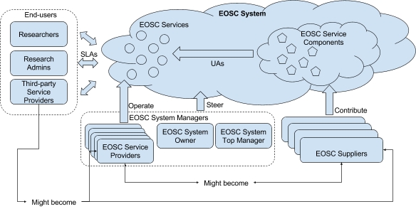
EOSC Actors and Roles
Whom should EOSC provide services to?
Notes:
Not only to scientists, but also to the stakeholders thet define policies and administer research activities, to the developers of external service that exploit EOSC ones and to al the administrators supplying components and providing services (including te managers of EOSC itself) ,

Slide 7
Typical activities
What actors with these roles do?
Researchers
Find, access, use/reuse, deposit, publish research artifacts, collaborate, open and track request for changes,…
Research Administrators
Monitor reserach outcomes, assess reserach impact, operate communication channels, open and track request for changes, ….
Third-party service providers
Finding,accessing, using EOSC Servicesl managing SLAs, Providng feedback on EOSC services, open and track request for changes, ….
Provide EOSC Service components and data, manage Underpinning Agreement, develop EOSC Services, …….
EOSC Supplier
EOSC System Managers
Govern the EOSC service provisioning system. Manage the EOSC system (e.g the EOSC Portfolio)

Slide 8
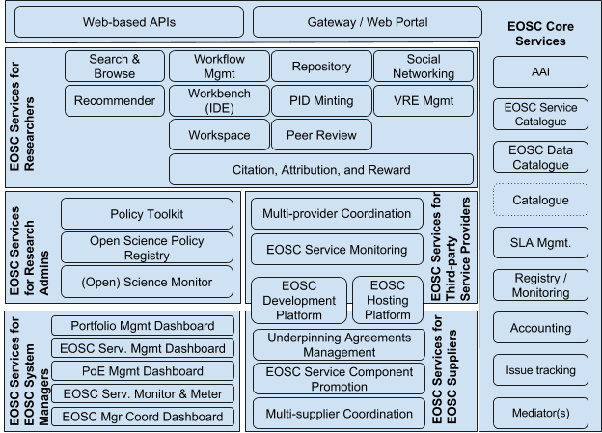
Service Categorization
What service types are needed to support these activities?

Slide 9
T5.1 Work plan 2018
Revise, enhance what done so far (actor roles, services, assumptions, etc.)
Select a set of services and identify alternative concrete architectures for them (selection in March/Pisa)
Establish links between components, policies, roles
Solutions should be based on existing resource providers compliant with future EOSC PoE. How to satisfy these constraints?
Discussion at the Pisa meeting
Glossary
Review terminology from WP2, WP3, WP5 and WP6 deliverables to extract terms and definitions
Presentation and discussion at the Pisa meeting
Discuss and harmonize

Slide 10
T5.1 Work plan 2018 (cont)
Select a number of services and specify their architecture /alternative architectures for them
e.g. service catalogue: centralised, distributed, replicated
Discuss deployment models for these services
e.g. Service catalogue: operated by a single entity? Replicas in Member States? Distributed in domain specific nodes?
Refine and consolidate the EOSC system model
→ Initial steps for the definition of an EOSC organizational architecture

Slide 11
T5.2 EOSC Service Portfolio (Lead: SURF)
Objectives
Define a portfolio of validated EOSC services
Define the related service portfolio management process and polices regulating service provisioning in EOSC

Slide 12
Task 5.2 EOSC Service Portfolio
Service Portfolio Management
The purpose of a Service Portfolio is to understand, both internally and externally, what services an organisation provides. This is necessary for effective service management as much of it is arranged and managed by service.
A Service Portfolio also help create an internal awareness within the organisation of the concept of a ‘Service’ from an ITSM point of view, rather than a more technology orientated point of view (which tends to refer to Service Components as Services).
Inclusion criteria
Removal criteria
Update criteria

Slide 13
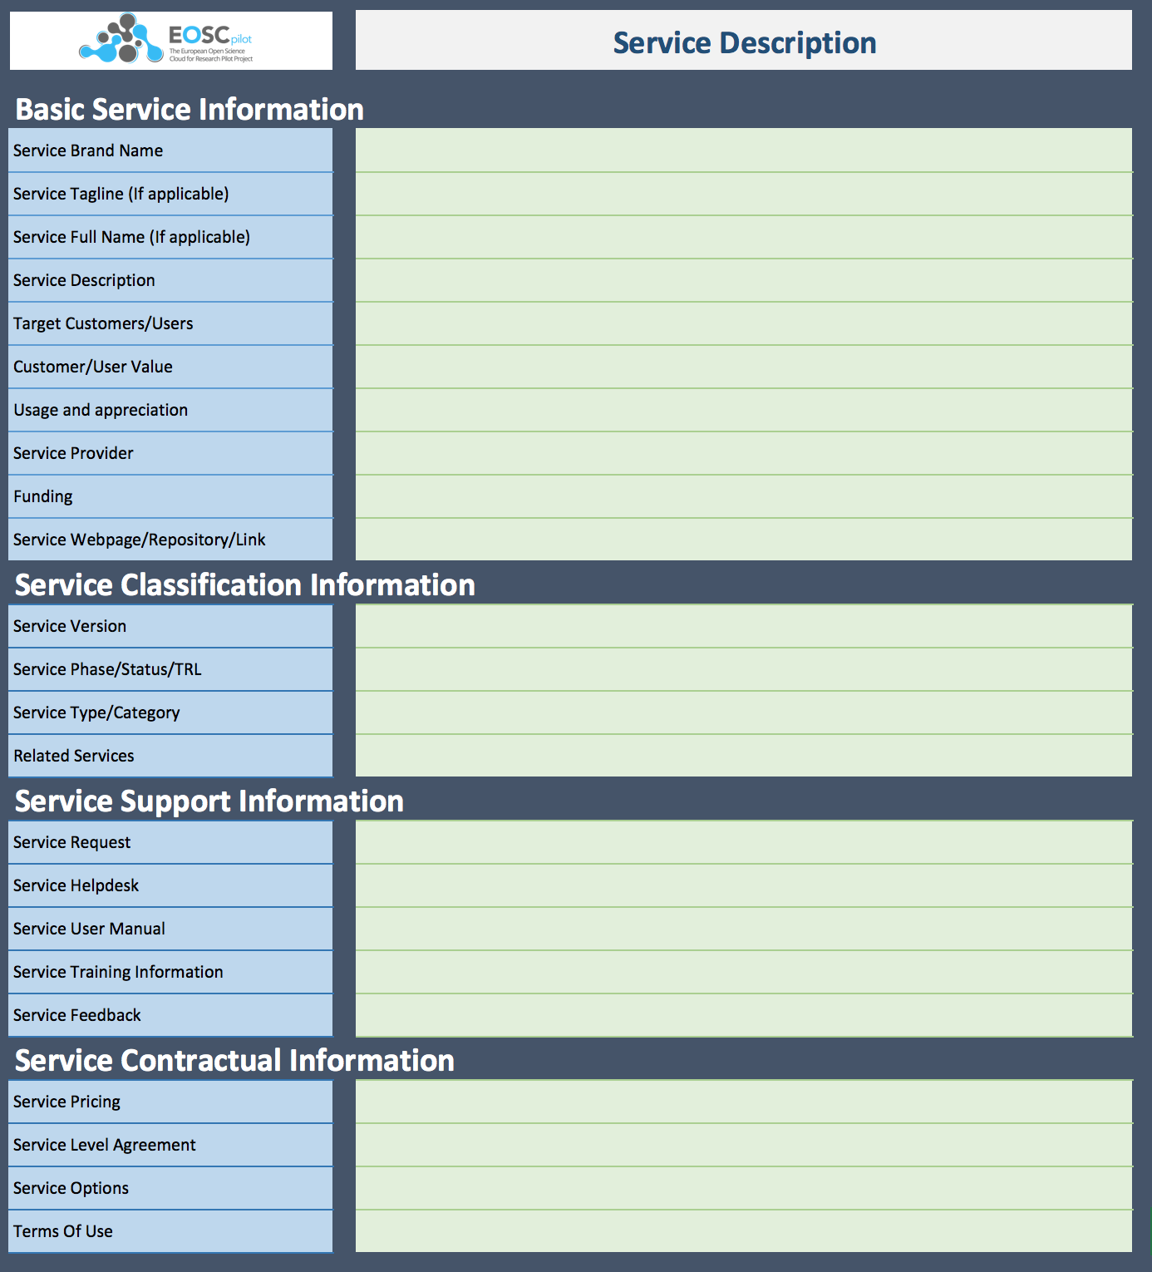
WP5.2 Activities
Collaboration with eInfraCentral
Sharing of service descriptions
Adoption of eInfraCentral Service Description Template
Gather input on service requirements from science demonstrators
In collaboration with T5.1, T5.4 and WP6
Description of services of project partners
Description of Service Portfolio Management (SPM) methodologies of project partners
First design of EOSC SPM process
More detailed description of output in D5.2 “EOSC Service Portfolio”
Notes:
Collaboration with eInfraCentral meant a shift in the task’s objectives.

Slide 14
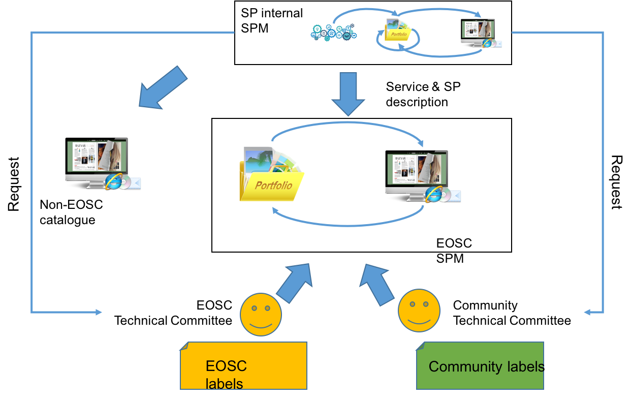
Service Portfolio Management: Challenges and first design
Federated setting: augment existing ITSM frameworks with EOSC specific processes when needed.
Provider heterogeneity: provide multiple levels of EOSC ‘compliance’ and ‘compatibility’ to be able to include providers with various maturity levels.
Consumer heterogeneity: enable communities / scientific disciplines to define their own set of requirements and provide the ability to label services according to their needs.
Service quality vs. inclusiveness: allow various levels of service quality but make sure services are properly described
Notes:
Structure of slide is Challenge: proposed solution.

Slide 15
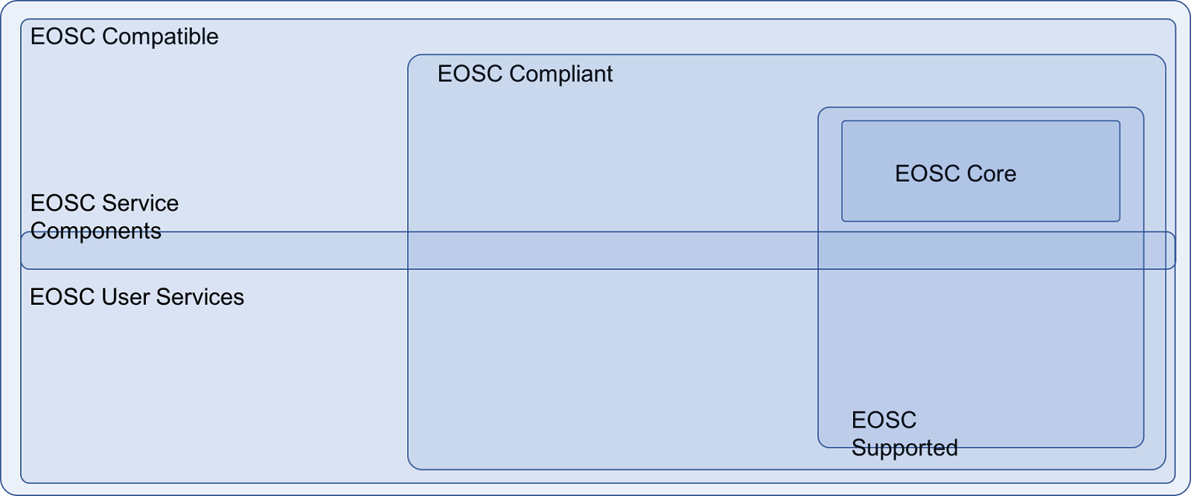
EOSC Service Categories
Service status:
EOSC Compatible: minimal requirements set by principles of engagement
EOSC Compliant: adherence to a more strict set of requirements posed by EOSC
Service sponsoring
EOSC Supported Services: Services that are commissioned and therefore financially supported by EOSC.
Service types & audience
Core Services: the fabric on which the EOSC is built, includes e.g. AAI, monitoring and accounting services.
Service components: e-infrastructure and software components that can be combined to create end-user services.
End-user services: services that are directly accessed by scientists
Notes:
Important to realise that services can be part of multiple categories, as shown in the Venn diagram.
Service status: how well does a service ‘fit in’ to EOSC?
Service sponsoring: how is a service being financed?
Service types & audience: who / what is the intended user of a service?

Slide 16
Service Portfolio: Minimal Requirements
Provide service & service provider descriptions
Only include actively supported services
Provide access route for international users
Be compliant with EU rules and regulations
→ Revise and expand in 2018

Slide 17
WP5.2 Work plan 2018
Determine what the ‘core services’ are and specify their functionality
Specify (in collaboration with other tasks) what the rules of engagement are for the various service categories are
Identify what service components are

Slide 18
T5.2 Federated Service Management Framework (Lead: CSC)
Objectives
Describe the implementation of IT Service Management (ITSM) principles, policies and structured processes of the EOSC
Define the operational constituents, roles and responsibilities of the EOSC Service Providers in order to ensure a high quality of the service delivery to the Customers and their users

Slide 19
Achievements & T5.3 Work plan 2018
M1-6: Review of existing service management frameworks and other rules followed by service providers
Initial survey focusing on existing e-Infrastructures & Research Infrastructures
EGI, EUDAT, PRACE, OpenAIRE, GEANT, ESFRIs, etc.
Scoping document
M6-12: Focus on Rules of Engagement (together with WP2)
Initial framing of the issue, discussion with stakeholders, public presentations (Pisa, Brussels, Porto)
M12-M18: Design of EOSC Service Management Framework
Objectives: lay down a few concepts and propose approach to organize and manage services within a future EOSC
Initial document (ongoing work)

Slide 20
Open Questions
EOSC doesn’t exist yet as an entity & its operational constituents are unclear
who are we “federating”? Individual service providers or existing federations (EGI, GEANT, EUDAT, ELIXIR, CLARIN, etc.)? Or both?
Heterogeneity of resource providers, with very different service management practices & standards
How to take this into account? Are we going for the lowest common denominator? For harmonization of practices?
Which organizational model? Central organisation managing core services & processes OR distributed model with shared responsibilities & roles
Where should our focus be?

Slide 21
ITSM and Governance
EOSC Governance owns the EOSC ITSM framework and decides about it
Inform the EOSCpilot consortium & future EOSC governing team about possible options
From distributed to centralised model
With analysis of pros & cons, as well as implications for each
Show what the ITSM would / should look like for each option

Slide 22
T5.4 Service Pilots (Lead: EGI Foundation)
Objectives
Provide necessary expertise on existing services and solutions
Analyze science demonstrator requirements, and translate them into a set of service capabilities and workflows, underpinning technical solutions and gaps, and service providers
Develop the technical bridges and provide a technical infrastructure on which the selected SDs can be exercised

Slide 23
Activities
Gathering of requirements (with WP4, WP6)
From: - The analysis of the work plans submitted by each SD (Intranet) - Collect additional requirements with the WP5 survey - Participation to WP4 regular meetings - Discussed interoperability issues with WP6 (if any)
Services identification (with WP6)
- Report the status of the pilots during the T5.4/T6.3 regular meetings - Invited speakers during T5.4/T6.3 meetings to bridge service gaps - Established a communication channels with service/resource providers to identify the services/solutions that best fit the needs of the SDs
Supervised the deployment of the pilots (with WP6)
- Checked the status reports produced by the pilots on regular basis - Get in touch with SDs shepherds/deputies

Slide 24
Common requirements
Transparent AAI at a global level
Provide easy-access services to open e-infrastructures to diverse communities
The implementation of this AAI architecture will be a keystone for the EOSC success
Data/Storage Interoperability
Many solutions are already available, the lack of full interoperability prevents seamless exploitation of e-Infrastructure and Research Infrastructure services
Computing Interoperability
Resource providers are offering different type of resources (e.g.: HTC, HPC and Cloud)
Bridges are needed to allow users to use these resources in a seamless manner

Slide 25
WP5 contribution to WP4 Science Demonstrators
First round of Science Demonstrators
Science Demonstrator | WP5 services
PanCancer | - Cloud Compute service (EGI FedCloud and ComputeCanada) - The EGI One Data Platform as storage
DPHEP | - B2SAFE as a Trusted Digital Repository (TDR) to store datasets - B2SHARE as documents repository - CernVMFS for storing the software and configuration - Cloud computing resources to allow data to be re-used using the CernVM
TextCrowd | - Cloud Compute to set up a VRE for the community based on the D4Science platform - Online Storage (B2DROP) where data sets and metadata can be stored/shared
ERFI | - Cloud Compute and Storage Service (The EGI Open Data Platform as data framework for sharing datasets)
Photon and Neutron | Used Cloud Compute services to improve the applications and make them more compliant with cloud technologies

Slide 26
WP5 contribution to WP4 Science Demonstrators (cont)
Second round of Science Demonstrators
Science Demonstrator | WP5 services
CryoEM | - No need to use any services from WP5 in this phase - Cloud Compute service for the execution of image processing workflow may be used as soon as the application is adapted
EPOS/VERCE | - Cloud Compute service (EGI FedCloud) - EUDAT storage solutions (To be used) - AAI (interested)
EGA datasets | - Possible need of additional providers (as soon as security policies are identified) - Metadata repository (e.g. B2FIND)
LOFAR | - HPC service - FAIR tools (under investigation) - AAI (interested)
PROMINENCE | Cloud Compute /Container service (EC3/IM) - PaaS Orchestrator - AAI (interested)

Slide 27
WP5 contribution to WP4 Science Demonstrators
(cont)
Third round of Science Demonstrators
Science Demonstrator | WP5 services
Bioimaging | - Cloud Compute resources at EMBL-EBI - B2SAFE to replicate data (in the future)
VisIVO | - Cloud Compute and HTC service - B2STAGE - AAI (interested)
VisualMedia | Cloud Compute service to set up a VRE for the community based on the D4Science platform
Hydrology | Storage Service (The EGI Open Data Platform as data repository)
Frictionless | No need to use any services from WP5

Slide 28
T5.4 Workplan 2018
Support the selected Science Demonstrators (cont.)
- Requests for new services/solutions needed by running SDs (see next slides) are collected from the:
- Interactions with the shepherds of each SD
- Participation to WP4 monthly meetings - Charing T5.4/T6.3 meetings
Assess the maturity of the EOSCpilot SDs
- Evaluate possible integration of SDs in the EOSC-hub project as new Thematic Services
Collect service pilots evaluation reports from SDs
- Regular basis reports available in the EOSCpilot Intranet

Slide 29
Issues
Diversity of stakeholders and services: limit initial work to ‘core services’ and work outwards from there
Circular project dependencies: bootstrap initial EOSC model and iteratively refine original setup
Community involvement: organise discussion sessions and face-to-face meetings
Different views on what EOSC is supposed to provide and who is going to serve
Complex and heterogeneous system-of-systems
EOSC as federation of “existing resources across national data centres, European e-infrastructures and research infrastructures”: not just a registry of existing components offered according established PoE
Large capacity requested, scalability issues of existing solutions

Slide 30
Plans for the plenary
Glossary, architecture and federated service management
DAY 1 11:00-12:30, 13:30-15:00
Federated service porfolio
DAY 2 11:00-12:30

